Slide 2




License
This work is licensed under a Creative Commons Attribution-NonCommercial-NoDerivatives 4.0 International.
This license requires that reusers give credit to the creator. It allows reusers to copy and distribute the material in any medium or format in unadapted form and for noncommercial purposes only.
BY: Credit must be given to you, the creator.
NC: Only noncommercial use of your work is permitted.
Noncommercial means not primarily intended for or directed towards commercial advantage or monetary compensation.
ND: No derivatives or adaptations of your work are permitted.

Slide 3

Attribution
When using this material, please credit KodeKloud as follows: "This training material is provided by KodeKloud (https://kodekloud.com) under the Creative Commons Attribution-NonCommercial 4.0 International License."
We would be absolutely thrilled if you took a selfie with your class and share it on social media while tagging us.

Slide 4
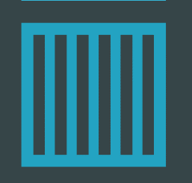


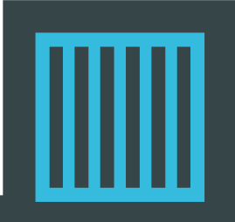

docker
Docker
for beginners
for beginners
© Copyright KodeKloud
Notes:
Hello and welcome to the Docker for Beginners course. My name is Mumshad Mannambeth and I will be your instructor for this course.

Slide 5
Objectives
01
What are Containers?
07
Networks in Docker
02
What is Docker?
08
Docker Compose
03
Why do you need it?
09
Docker Concepts in Depth
04
What can it do?
10
Docker for Windows/Mac
05
Run Docker Containers
11
Docker Swarm
06
Create a Docker Image
12
Docker vs Kubernetes
Notes:
But first let’s look at the objectives of this course. In this course we first try to understand what containers are, what docker is, why you might need it and what it can do for you. We will see how to Run a docker container, how to build your own docker image, networking in docker and how to use docker compose, what docker registry is, how to deploy your own private registry. We then look at some of these concepts in depth and we try to understand how docker really works. We look at Docker for Windows and MAC. Before finally getting a basic introduction to container orchestration tools like docker swarm and kubernetes.

Slide 7
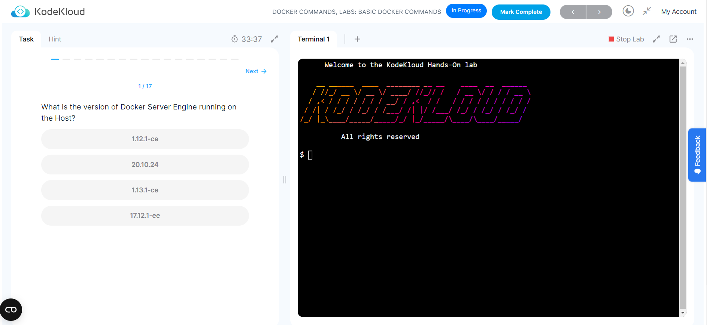
Access FREE KodeKloud hands-on labs for better learning experience.
Tap on this Link and SignUp for Docker labs course

Slide 8

Docker
Overview
© Copyright KodeKloud
Notes:
We are going to start by looking at a high level overview on why you need Docker and what it can do for you.

Slide 9
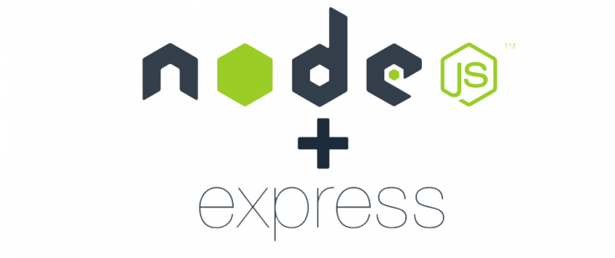




Need for Docker
Web Server
Database
Messaging
Orchestration
Compatibility/Dependency
Long setup time
Different Dev/Test/Prod environments
The Matrix from Hell !!
Libraries
Dependencies
OS
Hardware Infrastructure
Notes:
Let me start by sharing how I got introduced to Docker. In one of my previous projects, I had this requirement to setup an end-to-end application stack including various different technologies like a Web Server using NodeJS and a database such as MongoDB, and a messaging system like Redis and an orchestration tool like Ansible. We had a lot of issues developing this application with all these different components. First, their compatibility with the underlying OS. We had to ensure that all these different services were compatible with the version of the OS we were planning to use. There have been times when certain version of these services were not compatible with the OS, and we have had to go back and look for another OS that was compatible with all of these different services.
Secondly, we had to check the compatibility between these services and the libraries and dependencies on the OS. We have had issues were one service requires one version of a dependent library whereas another service required another version.
The architecture of our application changed over time, we have had to upgrade to newer versions of these components, or change the database etc and everytime something changed we had to go through the same process of checking compatibility between these various components and the underlying infrastructure. <click> This compatibility matrix issue is usually referred to as the matrix from hell.
Next, everytime we had a new developer on board, we found it really difficult to setup a new environment. The new developers had to follow a large set of instructions and run 100s of commands to finally setup their environments. They had to make sure they were using the right Operating System, the right versions of each of these components and each developer had to set all that up by himself each time.
We also had different development test and production environments. One developer may be comfortable using one OS, and the others may be using another one and so we couldn’t gurantee the application that we were building would run the same way in different environments. And So all of this made our life in developing, building and shipping the application really difficult.

Slide 10
What Can Docker Do?
Container
Container
Container
Container
Web Server
Database
Messaging
Orchestration
Containerize applications
Run each service with its own dependencies in separate containers
Libs
Deps
Libs
Deps
Libs
Deps
Libs
Deps
Docker
?
OS
Hardware Infrastructure
Notes:
So I needed something that could help us with the compatibility issue. And something that will allow us to modify or change these components without affecting the other components and even modify the underlying operating systems as required. And that search landed me on Docker. <click> With Docker I was able to run each component in a separate container – with its own libraries and its own dependencies. All on the same VM and the OS, but within separate environments or containers. We just had to build the docker configuration once, and all our developers could now get started with a simple “docker run” command. Irrespective of what underlying OS they run, all they needed to do was to make sure they had Docker installed on their systems.

Slide 11
Containers
Processes
Processes
Processes
Processes
Network
Network
Network
Network
Mounts
Mounts
Mounts
Mounts
Docker
OS Kernel
Notes:
So what are containers? Containers are completely isolated environments, as in they can have their own processes or services, their own network interfaces, their own mounts, just like Virtual machines, except that they all share the same OS kernel. We will look at what that means in a bit. But its also important to note that containers are not new with Docker. Containers have existed for about 10 years now and some of the different types of containers are LXC, LXD , LXCFS etc. Docker utilizes LXC containers. Setting up these container environments is hard as they are very low level and that is where Docker offers a high-level tool with several powerful functionalities making it really easy for end users like us.

Slide 12




Operating System
OS
Software
Software
Software
Software
OS Kernel
Notes:
To understand how Docker works let us revisit some basics concepts of Operating Systems first. If you look at operating systems like Ubuntu, Fedora, Suse or Centos – they all consist of two things. An OS Kernel and a set of software. The OS Kernel is responsible for interacting with the underlying hardware. While the OS kernel remains the same– which is Linux in this case, it’s the software above it that make these Operating Systems different. This software may consist of a different User Interface, drivers, compilers, File managers, developer tools etc. SO you have a common Linux Kernel shared across all OS’s and some custom softwares that differentiate Operating systems from each other.

Slide 13
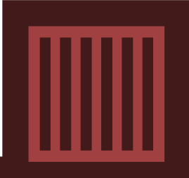

Sharing the Kernel
Software
Software
Software
Software
Docker
OS – Ubuntu
Notes:
We said earlier that Docker containers share the underlying kernel. What does that actually mean – sharing the kernel? Let’s say we have a system with an Ubuntu OS with Docker installed on it. Docker can run any flavor of OS on top of it as long as they are all based on the same kernel – in this case Linux. <click> If the underlying OS is Ubuntu, docker can run a container based on another distribution like debian, fedora, suse or centos. Each docker container only has the additional software, that we just talked about in the previous slide, that makes these operating systems different and docker utilizes the underlying kernel of the Docker host which works with all OS’s above.
So what is an OS that do not share the same kernel as these? Windows ! And so you wont be able to run a windows based container on a Docker host with Linux OS on it. For that you would require docker on a windows server.
Now, it is when I say this that most of my students go, hey hold on there! That’s not true. And they install docker on windows run a container based on linux and go “see its possible”. Well when you install docker on windows and run a Linux container on windows, you are not really running a Linux container on windows. Windows runs the linux container on a linux virtual machine under the hoods. So its really linux container on a linux virtual machine on windows. We discuss more about docker on windows or mac later during this course.
You might ask isn’t that a disadvantage then? Not being able to run another kernel on the OS? The answer is No! Because unlike hypervisors, Docker is not meant to virtualize and run different Operating systems and kernels on the same hardware. The main purpose of Docker is to package and containerize applications, to ship them and run them anywhere anytime and as many times as you want.

Slide 14
Containers vs Virtual Machines
GB
MB
Utilization
Size
Boot Up
Utilization
Size
Boot Up
Virtual Machine
Virtual Machine
Container
Container
Application
Application
Application
Application
Libs
Deps
Libs
Deps
OS
OS
Libs
Deps
Libs
Deps
Hypervisor
Docker
OS
Hardware Infrastructure
Hardware Infrastructure
Notes:
So that brings us to the differences between virtual machines and containers. Something that we tend to do, especially those from a Virtualization background.
As you can see on the right, in case of Docker, we have the underlying hardware infrastructure, then the OS, and Docker installed on the OS. Docker then manages the containers that run with libraries and dependencies alone. In case of a Virtual Machine, we have the OS on the underlying hardware, then the Hypervisor like ESX or some other virtualization technology and then the virtual machines. As you can see each virtual machine has its own OS inside it, then the dependencies and then the application.
This overhead causes higher utilization of underlying resources as there are multiple virtual operating systems and kernel running. The virtual machines also consume higher disk space as each VM is heavy and is usually in Giga Bytes in size, wereas docker containers are lightweight and are usually in Mega Bytes in size.
This allows docker containers to boot up faster, usually in a matter of seconds whereas VMs as we know takes minutes to boot up as it needs to bootup an entire OS.
It is also important to note that, Docker has less isolation as more resources are shared between containers like the kernel. Whereas VMs have complete isolation from each other. Since VMs don’t rely on the underlying OS or kernel, you can run different types of applications built on different OS’s such as linux based or windows based apps on the same hypervisor.
So those are some differences between the two.
Now having said that, it’s not an either container or virtual machine situation.

Slide 15
Containers and Virtual Machines
Virtual Machine
Virtual Machine
Container
Container
Container
Container
Application
Application
Application
Application
Libs
Deps
Libs
Deps
Libs
Deps
Libs
Deps
Docker
Docker
OS
OS
Hypervisor
Hardware Infrastructure
Notes:
It’s containers & virtual machines. When you have large environments with 1000s of application containers running on 1000s of docker hosts, you will often see containers provisioned on virtual docker hosts. That way we can utilize the advantages of both technologies. We can use the benefits of virtualization to easily provision or decommission docker hosts as required. At the same time make use of the benefits of Docker to easily provision applications and quickly scale them as required.

Slide 16




How Is It Done?
Public Docker registry – dockerhub
docker run ansible
docker run mongodb
docker run redis
docker run nodejs
docker run nodejs
docker run nodejs
Notes:
So how is it done? There are a lot of containerized versions of applications readily available as of today. So most organizations have their products containerized and available in a public docker repository called dockerhub/or docker store already. <show dockerhub>. For example you can find images of most common operating systems, databases and other services and tools. Once you identify the images you need and you install Docker on your host..
<click> bringing up an application stack, is as easy as running a docker run command with the name of the image. In this case running a docker run ansible command will run an instance of ansible on the docker host. Similarly run an instance of mongodb, redis and nodejs using the docker run command. If we need to run multiple instances of the web service, simply add as many instances as you need, and configure a load balancer of some kind in the front. <click> In case one of the instances fail, simply destroy that instance and launch a new one. There are other solutions available for handling such cases, that we will look at later during this course. And don’t focus on the commands too much for now. We will get to that in a bit.

Slide 17

Container vs Image
Docker Container #1
Package Template Plan
Docker Image
Docker Container #2
Docker Container #3
Notes:
We have been talking about images and containers. Let’s understand the difference between the two.
An image is a package or a template, just like a VM template that you might have worked with in the virtualization world. It is used to create one or more containers.
Containers are running instances off images that are isolated and have their own environments and set of processes
<show dockerhub> As we have seen before a lot of products have been dockerized already. In case you cannot find what you are looking for you could create an image yourself and push it to the Docker hub repository making it available for public.

Slide 19
Getting Started With Docker
Notes:
We will now see how to get started with Docker.

Slide 20
Docker Editions
Community Edition
Enterprise Edition
(Docker Business)
Notes:
<c> Docker has 2 editions. The community edition and the enterprise edition. The community edition is the set of free Docker products. The Enterprise edition is the certified and supported container platform that comes with enterprise add-ons like the Image management, image security, Universal Control Plane for managing and orchestrating container runtimes. But of course these come with a price. We will discuss more about container orchestration later in this course and along with some alternatives.
References: https://www.docker.com/products/business/

Slide 21




Community Edition
Linux
MAC
Windows
Cloud
Notes:
For now we will go ahead with the community edition.
The community edition is available on Linux, Mac, Windows or on Cloud platforms like AWS or Azure.

Slide 23
Docker Commands
Notes:
We now look at some of the Docker commands. At the end of this lecture, you will go through a hands-on quiz where you will practice working with these commands.

Slide 24

Run – Start a Container
docker run nginx
Unable to find image 'nginx:latest' locally
latest: Pulling from library/nginx
fc7181108d40: Already exists
d2e987ca2267: Pull complete
0b760b431b11: Pull complete
Digest: sha256:96fb261b66270b900ea5a2c17a26abbfabe95506e73c3a3c65869a6dbe83223a
Status: Downloaded newer image for nginx:latest
Notes:
Let’s start by looking at the Docker Run command. The Docker run command is used to run a container from an image. Running the docker run nginx command will run an instance of the nginx image on the Docker host if it already exists. If the image is not present on the host it will go out to docker hub and pull the image down, but this is only done the first time. For subsequent executions the same image will be used.

Slide 25
ps – List Containers
docker ps
CONTAINER ID IMAGE COMMAND CREATED STATUS PORTS NAMES
796856ac413d nginx "nginx -g 'daemon of…" 7 seconds ago Up 6 seconds 80/tcp silly_sammet
docker ps -a
CONTAINER ID IMAGE COMMAND CREATED STATUS NAMES
796856ac413d nginx "nginx -g 'daemon of…" 7 seconds ago Up 6 seconds silly_sammet
cff8ac918a2f redis "docker-entrypoint.s…" 6 seconds ago Exited (0) 3 seconds ago relaxed_aryabhata
Notes:
The docker ps command lists all running containers and some basic information about them. Such as the container ID, the name of the image we used to run the containers, the current status and the name of the container. Each container automatically gets a random ID and name created for it by docker which in this case is silly_sammet.
To see all containers running or not, use the –a option. This outputs all running as well as previously exited containers.
We will talk about the command and port fields shown in this output later in this course. For now let’s just focus on the basic details.

Slide 26
STOP – Stop a Container
docker ps
CONTAINER ID IMAGE COMMAND CREATED STATUS PORTS NAMES
796856ac413d nginx "nginx -g 'daemon of…" 7 seconds ago Up 6 seconds 80/tcp silly_sammet
docker stop silly_sammet
silly_sammet
docker ps -a
CONTAINER ID IMAGE COMMAND CREATED STATUS NAMES
796856ac413d nginx "nginx -g 'daemon of…" 7 seconds ago Exited (0) 3 seconds ago silly_sammet
cff8ac918a2f redis "docker-entrypoint.s…" 6 seconds ago Exited (0) 3 seconds ago relaxed_aryabhata
Notes:
To stop a running container, use the docker stop command. But you must provide either the container ID or the container name in the stop command. If you are not sure of the name run the docker ps command to get it. On success you will see the name printed out and running docker ps again will show no running containers. Running docker ps –a however shows the container silly_sammet and that it exited a few seconds ago.
[pause]
Now, what if we don’t want this container lying around consuming space? What if we want to get rid of it for good?

Slide 27
Rm – Remove a Container
docker rm silly_sammet
silly_sammet
docker ps -a
CONTAINER ID IMAGE COMMAND CREATED STATUS NAMES
cff8ac918a2f redis "docker-entrypoint.s…" 6 seconds ago Exited (0) 3 seconds ago relaxed_aryabhata
Notes:
Use docker rm command to remove a stopped or exited container permanently. If it prints the name back we are good.
Run the docker ps command again to verify that it’s no longer present.
Good, but what about the nginx image that was downloaded at first. We are not using that anymore, how do we get rid of that?

Slide 28
images – List Images
docker images
REPOSITORY TAG IMAGE ID CREATED SIZE
nginx latest f68d6e55e065 4 days ago 109MB
redis latest 4760dc956b2d 15 months ago 107MB
ubuntu latest f975c5035748 16 months ago 112MB
alpine latest 3fd9065eaf02 18 months ago 4.14MB
Notes:
But first, how do we see a list of images present on our host? Run the docker images command to see a list of available images and their sizes. On our host we have 4 images – nginx, redis, ubuntu and alpine. We will talk about tags later in this course when we discuss more about images.

Slide 29
rmi – Remove Images
docker rmi nginx
Untagged: nginx:latest
Untagged: nginx@sha256:96fb261b66270b900ea5a2c17a26abbfabe95506e73c3a3c65869a6dbe83223a
Deleted: sha256:f68d6e55e06520f152403e6d96d0de5c9790a89b4cfc99f4626f68146fa1dbdc
Deleted: sha256:1b0c768769e2bb66e74a205317ba531473781a78b77feef8ea6fd7be7f4044e1
Deleted: sha256:34138fb60020a180e512485fb96fd42e286fb0d86cf1fa2506b11ff6b945b03f
Deleted: sha256:cf5b3c6798f77b1f78bf4e297b27cfa5b6caa982f04caeb5de7d13c255fd7a1e
! Delete all dependent containers to remove image
Notes:
To remove an image that you no longer plan to use, Run the docker rmi command. Remember, you must ensure no containers are running off that image before attempting to remove the image. You must stop and delete all dependent containers to be able to delete an image.

Slide 30
Pull – Download an Image
docker run nginx
Unable to find image 'nginx:latest' locally
latest: Pulling from library/nginx
fc7181108d40: Already exists
d2e987ca2267: Pull complete
0b760b431b11: Pull complete
Digest: sha256:96fb261b66270b900ea5a2c17a26abbfabe95506e73c3a3c65869a6dbe83223a
Status: Downloaded newer image for nginx:latest
docker pull nginx
Using default tag: latest
latest: Pulling from library/nginx
fc7181108d40: Pull complete
d2e987ca2267: Pull complete
0b760b431b11: Pull complete
Digest: sha256:96fb261b66270b900ea5a2c17a26abbfabe95506e73c3a3c65869a6dbe83223a
Status: Downloaded newer image for nginx:latest
Notes:
When we ran the docker run command earlier, it downloaded the Ubuntu image as it couldn’t find one locally. What if we simply want to download the image and keep so when we use run command we don’t have to wait for it to download? Use the docker pull Ubuntu command to only pull the image.

Slide 31
docker run ubuntu
docker ps
CONTAINER ID IMAGE COMMAND CREATED STATUS PORTS
docker ps -a
CONTAINER ID IMAGE COMMAND CREATED STATUS PORTS
45aacca36850 ubuntu "/bin/bash" 43 seconds ago Exited (0) 41 seconds ago
Notes:
Let’s look at another example. <c> Say you were to run a docker container from an Ubuntu image. When you run the “docker run ubuntu” command, it runs an instance of Ubuntu image and exits immediately. <c> If you were to list the running containers you wouldn’t see the container running. <c> If you list all containers including those that are stopped, you will see that the new container you ran is in an Exited state. Now why is that?

Slide 32

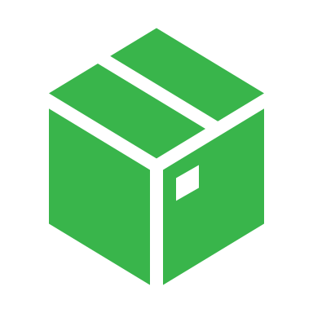
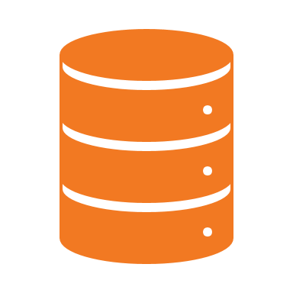
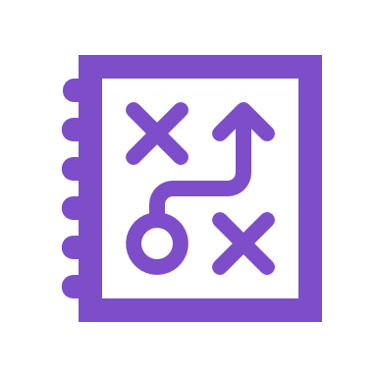

docker run ubuntu
docker ps
CONTAINER ID IMAGE COMMAND CREATED STATUS PORTS
docker ps -a
CONTAINER ID IMAGE COMMAND CREATED STATUS PORTS
45aacca36850 ubuntu "/bin/bash" 43 seconds ago Exited (0) 41 seconds ago
Notes:
Unlike Virtual Machines, containers are not meant to host an Operating System. <c> Containers are meant to run a specific task or process. Such as to host an instance of a Web Server, or Application Server or a database or simply to carry out some kind of computation or analysis. <c> Once the task is complete the container exits. A container only lives as long as the process inside it is alive. If the web service inside the container is stopped or crashes the container exits.
This is why when you run a container from an Ubuntu image, it stops immediately. Because Ubuntu is just an image of an operating system that is used as the base image for other applications. There is no process or application running in it by default.

Slide 33

Append a Command
docker run ubuntu
docker run ubuntu sleep 5
1
2
3
4
5
Notes:
If the image isn’t running any services as is the case with Ubuntu, you could instruct docker to run a process, with the docker run command. For example a sleep command with a duration of 5 seconds. When the container starts it runs the sleep command and goes into sleep for 1000 seconds. Post which the sleep command exits and the container stops.

Slide 34
Exec – Execute a Command
docker ps -a
CONTAINER ID IMAGE COMMAND CREATED STATUS NAMES
538d037f94a7 ubuntu "sleep 100“ 6 seconds ago Up 4 seconds distracted_mcclintock
docker exec distracted_mcclintock cat /etc/hosts
127.0.0.1 localhost
::1 localhost ip6-localhost ip6-loopback
fe00::0 ip6-localnet
ff00::0 ip6-mcastprefix
ff02::1 ip6-allnodes
ff02::2 ip6-allrouters
172.18.0.2 538d037f94a7
Notes:
What we just saw was executing a command when we run the container. But what if we would like to execute a command on a running container. For example, when I run the docker ps command I can see that there is a running container which uses the Ubuntu image and sleeps for 100 seconds. Let’s say I would like to see the contents of a file inside the running container. I could use the docker exec command to execute a command on my docker container. In this case to print the contents of the /etc/hosts file.

Slide 35
Run – Attach and Detach
docker run kodekloud/simple-webapp
This is a sample web application that displays a colored background.
* Serving Flask app "app" (lazy loading)
* Running on http://0.0.0.0:8080/ (Press CTRL+C to quit)
docker run –d kodekloud/simple-webapp
a043d40f85fefa414254e4775f9336ea59e19e5cf597af5c554e0a35a1631118
docker attach a043d
Notes:
Finally, let’s look at one more option before we head over to the practice exercises.
I am now going to run a Docker image I developed for a simple web application. The repository name is kodekloud/simple-webapp. It runs a simple web server that listens on port 8080. When you run a docker run command like this, it runs in a foreground or in an attached mode, meaning you will be attached to the console or standard out of the docker container and you will see the output of the web service on your screen. You won’t be able to do anything else on this console other than view the output until this docker container stops. It won’t respond to yours inputs. Press CTRL + C to stop the container and the application hosted on the container exits.
Another option is to run the docker container in the detached mode by providing the –d option. This will run the docker container in the background mode and you will be back to your prompt.
If you would like to attach back to the running container later, run the docker attach command and specify the name or ID of the docker container. Remember if you are specifying the ID of a container in any docker command, you can simply provide the first few characters alone, just so it is different enough from other container IDs on the host. In this case I specify a043d
Don’t worry about accessing the UI of the web server for now. We will more into that in the upcoming lectures. For now let’s get our hands dirty with the Docker CLI, so let’s take a look at how to access the practice lab environments next.

Slide 36
It's time to do a hands-on lab on
Basic Docker Commands
Tap on this Link to access the lab

Slide 38
Docker Run Commands
Notes:
We will now look at some of the other Docker run commands. At the end of this lecture, you will go through a hands-on quiz where you will practice working with these commands.

Slide 39
Run – Tag
docker run redis
Using default tag: latest
latest: Pulling from library/redis
f5d23c7fed46: Pull complete
Status: Downloaded newer image for redis:latest
1:C 31 Jul 2019 09:02:32.624 # oO0OoO0OoO0Oo Redis is starting oO0OoO0OoO0Oo
1:C 31 Jul 2019 09:02:32.624 # Redis version=5.0.5, bits=64, commit=00000000, modified=0, pid=1, just started
1:M 31 Jul 2019 09:02:32.626 # Server initialized
TAG
docker run redis:4.0
Unable to find image 'redis:4.0' locally
4.0: Pulling from library/redis
e44f086c03a2: Pull complete
Status: Downloaded newer image for redis:4.0
1:C 31 Jul 09:02:56.527 # oO0OoO0OoO0Oo Redis is starting oO0OoO0OoO0Oo
1:C 31 Jul 09:02:56.527 # Redis version=4.0.14, bits=64, commit=00000000, modified=0, pid=1, just started
1:M 31 Jul 09:02:56.530 # Server initialized
Notes:
We learned that we could use the <c> docker run redis command to run a container running a redis service. In this case the latest version of redis which happens to be <c> 5.0.5. But what if we want to run another version of redis? Like for example an older version say 4.0. Then you specify the version separated by a colon. This is called a tag. In that case docker pulls an image of the 4.0 version of redis and runs that.
<click> Also, notice that if you don’t specify any tag as in the first command, docker will consider the default tag to be “latest”. “latest” is a tag associated to the latest version of that software which is governed by the authors of that software.
So as a user how do you find information about these versions and what is latest? At docker <c> hub.com look up an image and you will find all the supported tags in its description. Each version of the software can have multiple short and long tags associated with it as seen here.

Slide 40
RUN – STDIN
~/prompt-application$
./app.sh
Welcome! Please enter your name:
Mumshad
Hello and Welcome Mumshad!
docker run kodekloud/simple-prompt-docker
Hello and Welcome !
docker run –i kodekloud/simple-prompt-docker
Mumshad
Hello and Welcome Mumshad!
docker run –it kodekloud/simple-prompt-docker
Welcome! Please enter your name:
Mumshad
Hello and Welcome Mumshad!
Notes:
Let’s look at Inputs.
<c> I have a simple prompt application that when run <click> asks for my name. And on entering my name prints a welcome message.
<c> If I were to dockerize this application and run it as a docker container like this, it wouldn’t wait for the prompt. It just prints whatever the application is supposed to print on standard out. That is because by default the docker container doesn’t listen to a Starndard Input. Even though you are attached to its console, it is not able to read any input from you. It doesn’t have a terminal to read inputs from. It runs in a non-interactive mode.
<c> If you’d like to provide your input you must map the standard input of your host to the docker container using the -I parameter. The –i is for interactive mode. And when I input my name it prints the expected output. But there is something still missing from this. The prompt.
<c> When we ran the app, it asked us for our name. But when dockerized that prompt is missing, even though it seems to have accepted my input. That is because the application prompts on the terminal. And we have not attached to the containers terminal.
<c> For this use the –t option as well. The –t stands for psueod terminal.

Slide 41

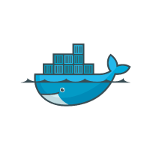
Run – PORT Mapping
docker run kodekloud/webapp
http://192.168.1.5:80
Docker Host
* Running on http://0.0.0.0:5000/ (Press CTRL+C to quit)
80
8000
8001
IP: 192.168.1.5
http://172.17.0.2:5000
Internal IP
Web APP
Docker Container
Web APP
Docker Container
Web APP
Docker Container
5000
5000
5000
docker run –p 80:5000 kodekloud/simple-webapp
IP: 172.17.0.2
IP: 172.17.0.3
IP: 172.17.0.4
3306
docker run –p 8000:5000 kodekloud/simple-webapp
MySQL
Docker Container
MySQL
Docker Container
MySQL
Docker Container
docker run –p 8001:5000 kodekloud/simple-webapp
3306
IP: 172.17.0.5
3306
IP: 172.17.0.6
3306
IP: 172.17.0.6
docker run –p 3306:3306 mysql
8306
docker run –p 8306:3306 mysql
docker run –p 8306:3306 mysql
Notes:
We will now look at port mapping or port publishing on containers.
Let’s go back to the example were we run a simple web application in a docker container on my docker host. Remember the underlying host were docker is installed is called Docker Host or Docker Engine. When we run a containerized web application, it runs and we are able to see that the server is running, <click> but how does a user access my application? <click> As you can see my application is listening on port 5000. So I could access my application by using port 5000. But what IP do I use to access it from a web browser?
<click>
There are two options available. One is to use the IP of the docker container. Every docker container gets an IP assigned by default. In this case it is 172.17.0.2. But remember that this is an internal IP and is only accessible within the docker host. So if you open a browser from within the docker host, you can go to <click> http://172.17.0.1:5000 to access the IP address.
But since this is an internal IP users outside of the Docker Host cannot access it using this IP. For this we could use the IP of Docker Host, which is 192.168.1.5 in this case. But for that to work, you must have mapped the port inside the docker container to a free port on the Docker host. For example, if I want the users to access my application through port 80 on my Docker host, I could map the port 80 of local host to port 5000 on the docker container using the –p parameter in my run command like this <click>. And so the user can access my application by going to URL http://192.168.1.5:80 and all traffic on port 80 on my Docker host will get routed to port 5000 inside the docker container.
<click> This way you can run multiple instances of your application and map them to different ports on the docker host.
<click> Or run instances of different applications on different ports. For example, in this case I am running an instance of mysql that runs a database on my and listens on the default mysql port 3306 or another instance of mysql on another port 8306.
So you can run as many applications like this and map them to as many ports as you want. And of course you cannot map to the same port on the Docker host more than once.
We will discuss more about port mapping and networking of containers in the Network lecture later on.

Slide 42
RUN – Volume Mapping
Docker Host
docker run mysql
MYSQL
Docker Container
Data
Data
/opt/datadir
docker stop mysql
docker rm mysql
/var/lib/mysql
/opt/datadir
docker run –v /opt/datadir:/var/lib/mysql mysql
Notes:
Let’s now look at how data is persisted in a Docker container. For example, <click> let’s say you were to run a mysql container. When databases and tables are created, the data files are stored in location /var/lib/mysql inside the docker container. Remember, the docker container has its own isolated file system and any changes to any files happen within the container.
Let’s assume you dump a lot of data in the database. What happens if you were to delete the mysql container and remove it?
<click> As soon as you do that, the container along with all the data inside it gets blown away. Meaning all your data is gone. If you would like to persist data you would want to map a directory outside the container on the Docker host to a directory inside the container. In this case I create a directory called /opt/datadir and map that to /var/lib/mysql inside the docker container using the –v option and specifying the directory on the docker host followed by a colon and the directory inside the docker container. This way when docker container runs it will implicitly mount the external directory to a folder inside the docker container. This way all your data will now be stored in the external volume at /opt/datadir and thus will remain even if you delete the docker container.

Slide 43
Inspect Container
docker inspect blissful_hopper
[
{
"Id": "35505f7810d17291261a43391d4b6c0846594d415ce4f4d0a6ffbf9cc5109048",
"Name": "/blissful_hopper",
"Path": "python",
"Args": [
"app.py"
],
"State": {
"Status": "running",
"Running": true,
},
"Mounts": [],
"Config": {
"Entrypoint": [
"python",
"app.py"
],
},
"NetworkSettings": {..}
}
]
Notes:
The docker ps command is good enough to get basic details about containers like their names, and ids. But if you’d like to see additional details about a specific container, use the docker inspect command and provide the container name or ID. It returns all details of a container in a JSON format, such as the state, mounts, configuration data, network settings etc. Remember to use it when you are required to find details on a container.
That’s it for this lecture. Head over to the challenges and practice working with docker commands.

Slide 44
Container Logs
docker logs blissful_hopper
This is a sample web application that displays a colored background.
A color can be specified in two ways.
1. As a command line argument with --color as the argument. Accepts one of red,green,blue,blue2,pink,darkblue
2. As an Environment variable APP_COLOR. Accepts one of red,green,blue,blue2,pink,darkblue
3. If none of the above then a random color is picked from the above list.
Note: Command line argument precedes over environment variable.
No command line argument or environment variable. Picking a Random Color =blue
* Serving Flask app "app" (lazy loading)
* Environment: production
WARNING: Do not use the development server in a production environment.
Use a production WSGI server instead.
* Debug mode: off
* Running on http://0.0.0.0:8080/ (Press CTRL+C to quit)
Notes:
And finally, how do we see the logs of a container we ran in the background? For example, I ran my sample webapplication using the –d parameter and it ran the container in a detached mode. How do I view the logs, which happens to be the contents written to the standardout of that container? Use the docker logs command and specify the container id or name like this.

Slide 45
It's time to do a hands-on lab on
Docker Run Commands
Tap on this Link to access the lab

Slide 47
Docker
Environment Variables
Notes:
We now look at some of the Docker commands. At the end of this lecture, you will go through a hands-on quiz where you will practice working with these commands.

Slide 48
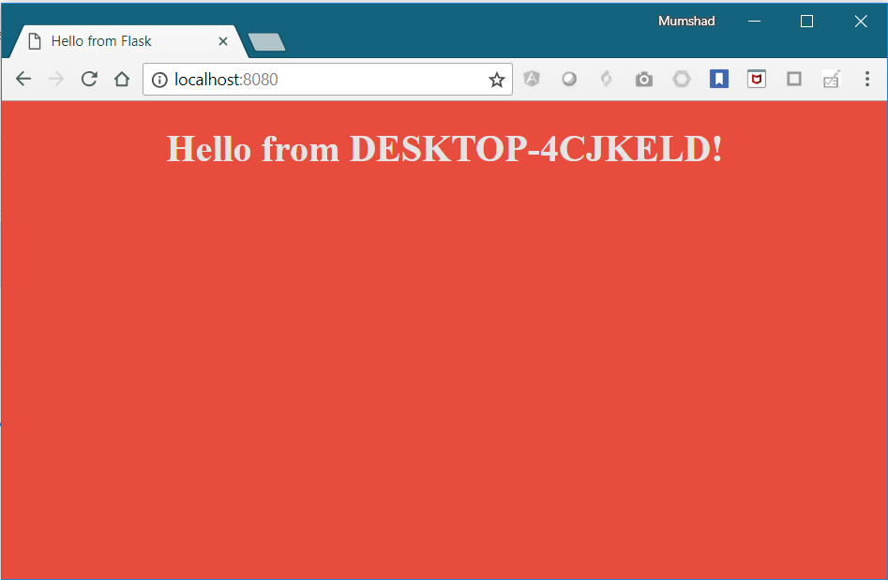
Environment Variables
app.py
import os from flask import Flask app = Flask(__name__)
…
…
color = "red" @app.route("/") def main(): print(color) return render_template('hello.html', color=color) if __name__ == "__main__": app.run(host="0.0.0.0", port="8080")
python app.py
Notes:
Let us start with a simple web application written in Python. <click> This piece of code is used to create a web application that displays a webpage with a background color.

Slide 49
Environment Variables
app.py
import os from flask import Flask app = Flask(__name__)
…
…
color = "red" @app.route("/") def main(): print(color) return render_template('hello.html', color=color) if __name__ == "__main__": app.run(host="0.0.0.0", port="8080")
Notes:
If you look closely into the application code, you will see a line that sets the background color to red. Now, that works just fine. However, if you decide to change the color in the future, you will have to change the application code. It is a best practice to move such information out of the application code.

Slide 50
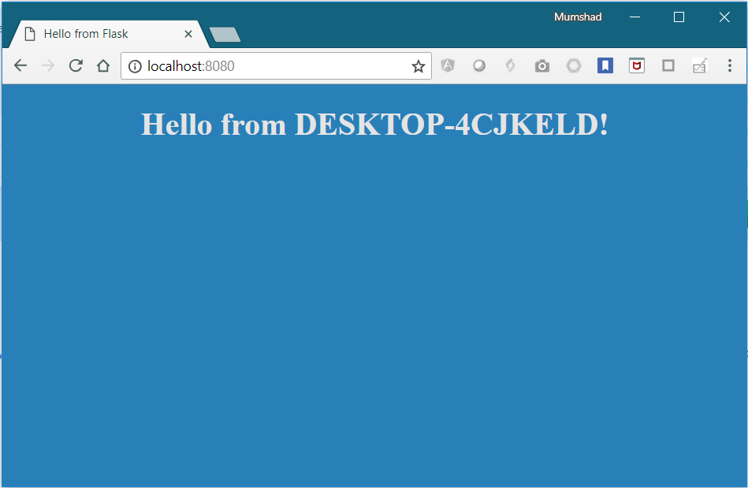
Environment Variables
app.py
import os from flask import Flask app = Flask(__name__)
…
…
color = os.environ.get('APP_COLOR','red')
@app.route("/") def main(): print(color) return render_template('hello.html', color=color) if __name__ == "__main__": app.run(host="0.0.0.0", port="8080")
export APP_COLOR=blue; python app.py
Notes:
And into, say an environment variable called APP_COLOR. The next time you run the application, set an environment variable called APP_COLOR to a desired value, and the application now has a new color.

Slide 51
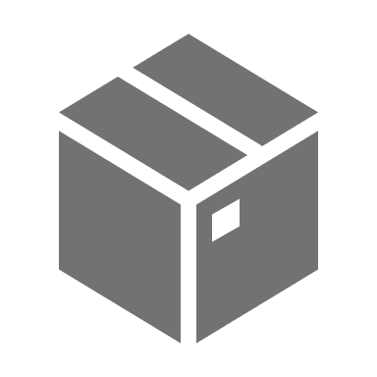
ENV Variables in Docker
app.py
import os from flask import Flask app = Flask(__name__)
…
…
color = "red" @app.route("/") def main(): print(color) return render_template('hello.html', color=color) if __name__ == "__main__": app.run(host="0.0.0.0", port="8080")
os.environ.get('APP_COLOR')
simple-webapp-color
docker run
Notes:
Once your application get’s packaged into a Docker image, you would then run it with the docker run command followed by the name of the image. However, if you wish to pass the environment variable as we did before, you would now use the docker run command’s –e option to set an environment variable within the container.

Slide 52
ENV Variables in Docker
docker run
-e APP_COLOR=blue
Notes:
Once your application get’s packaged into a Docker image, you would then run it with the docker run command followed by the name of the image. However, if you wish to pass the environment variable as we did before, you would now use the docker run command’s –e option to set an environment variable within the container.

Slide 53
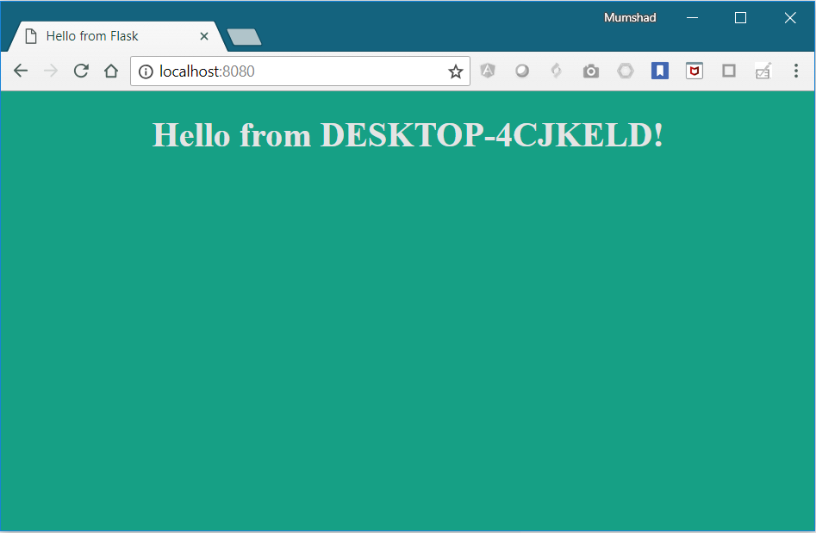
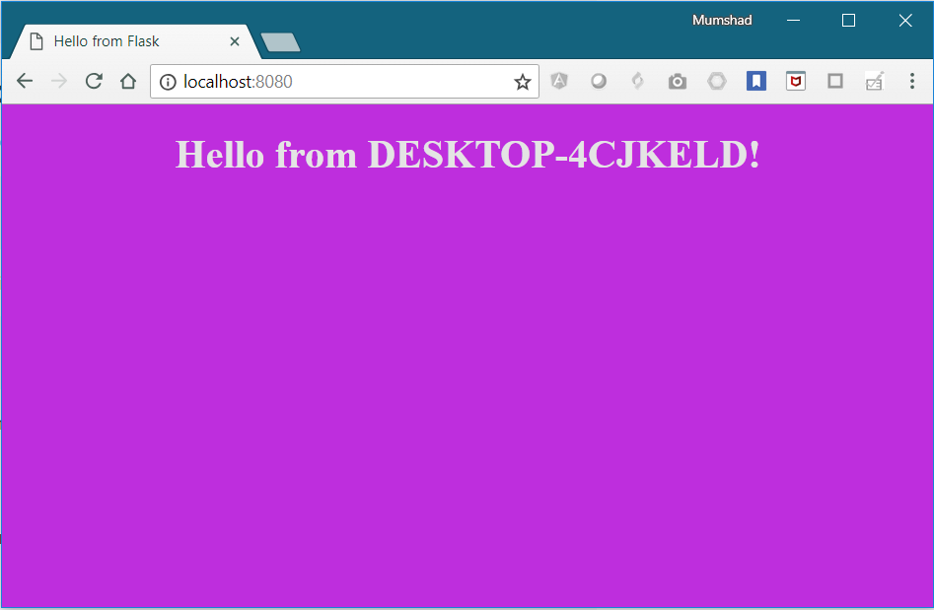
ENV Variables in Docker
docker run
-e APP_COLOR=blue
simple-webapp-color
docker run -e APP_COLOR=green simple-webapp-color
docker run -e APP_COLOR=pink simple-webapp-color
Notes:
To deploy multiple containers with different colors, you would run the docker command multiple times and set a different value for the environment variable each time.

Slide 54
Inspect Environment Variable
docker inspect blissful_hopper
[
{
"Id": "35505f7810d17291261a43391d4b6c0846594d415ce4f4d0a6ffbf9cc5109048",
"State": {
"Status": "running",
"Running": true,
},
"Mounts": [],
"Config": {
"Env": [
"APP_COLOR=blue",
"LANG=C.UTF-8",
"GPG_KEY=0D96DF4D4110E5C43FBFB17F2D347EA6AA65421D",
"PYTHON_VERSION=3.6.6",
"PYTHON_PIP_VERSION=18.1"
],
"Entrypoint": [
"python",
"app.py"
],
}
]
Notes:
So how do you find the environment variable set on a container that’s already running? <c> Use the docker inspect command to inspect the properties of a running container. Under the config section you will find the list of environment variables set on the container.

Slide 55
It's time to do a hands-on lab on
Environment Variables
Tap on this Link to access the lab

Slide 57
Docker
Images
Notes:
We now look at some of the Docker commands. At the end of this lecture, you will go through a hands-on quiz where you will practice working with these commands.

Slide 58

What to Containerize?
Notes:
Why would you need to create your own image? It could either be because you cannot find a component/service that you want to use as part of your application. Or you and your team decided that the application you are developing will be dockerized for ease of shipping and deployment.

Slide 59
Creating My Own Image
Dockerfile
1. OS - Ubuntu
FROM Ubuntu
RUN apt-get update
RUN apt-get install python
RUN pip install flask
RUN pip install flask-mysql
COPY . /opt/source-code
ENTRYPOINT FLASK_APP=/opt/source-code/app.py flask run
2. Update apt repo
3. Install dependencies using apt
4. Install Python dependencies using pip
5. Copy source code to /opt folder
6. Run the web server using “flask” command
docker build Dockerfile –t mmumshad/my-custom-app
Docker Registry
docker push mmumshad/my-custom-app
Notes:
First we need to understand what we are containerizing or what application we are creating an image for and how the application is built. So start by thinking what you might do if you want to deploy the application manually. We write down the steps required in the right order. I am creating an image for a simple web application. If I were to set it up manually, I would start with an OS like Ubuntu, then update source repositories using apt command, then install dependencies using apt command. Then install the python dependencies using pip and then COPY the source code of my application to a location like /opt. And finally run the web server using flask command. Now that I have the instructions, create a Dockerfile using these. Here is a quick overview of the process of creating your own image. Create a Dockerfile named “Dockerfile” and write down instructions for setting up your application in it. Such as installing dependencies, were to copy the source code from and what the entrypoint of the application is etc. Once done, build your image using docker build command and specify the Dockerfile as input as well as a tag name for the image. This will create an image locally on your system. To make it available on the public Docker registry, run the docker push command and specify the name of the image you just created.

Slide 60
Dockerfile
Dockerfile
INSTRUCTION
INSTRUCTION
ARGUMENT
ARGUMENT
Dockerfile
Start from a base OS or another image
FROM Ubuntu
RUN apt-get update
RUN apt-get install python
RUN pip install flask
RUN pip install flask-mysql
COPY . /opt/source-code
ENTRYPOINT FLASK_APP=/opt/source-code/app.py flask run
Install all dependencies
Copy source code
Specify Entrypoint
Notes:
Now let’s take a closer look at that Dockerfile. Dockerfile is a text file written in a specific format that Docker can understand. It’s in an Instruction and arguments format.
<click> For example, in this Dockerfile everything on the left in CAPs is an instruction. In this case FROM, RUN, COPY and ENTRYPOINT are all instructions. Each of these instruct Docker to perform a specific action while creating the image. <click> Everything on the right is argument to those instructions. <click>
The first line, From Ubuntu, defines what the base OS should be for this container. Every docker image must be based of another image. <click> Either an OS or another image that was created before based on an OS. You can find official releases of all Operating Systems on docker hub. Note that all Dockerfiles must start with a FROM instruction.
The RUN instruction instructs Docker to run the command on those base images. <click> So at this point Docker runs the apt-get update command to fetch updated packages and installs required dependencies on the image.
<click> Then the COPY instruction copies files from local system into the Docker image. In this case the source code of our application is in the current folder and I will be copying it over to location /opt/source-code inside the docker image. <click>
And finally ENTRYPOINT allows us to specify a command that will be run when the image is run as a container.

Slide 61
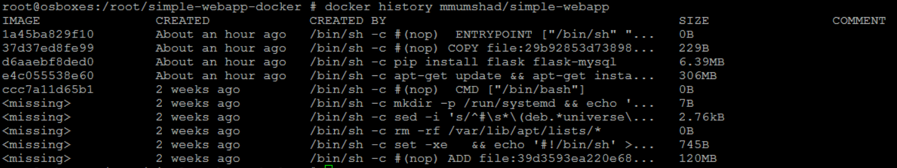
Layered Architecture
Dockerfile
docker build Dockerfile –t mmumshad/my-custom-app
FROM Ubuntu
RUN apt-get update && apt-get –y install python
RUN pip install flask flask-mysql
COPY . /opt/source-code
ENTRYPOINT FLASK_APP=/opt/source-code/app.py flask run
Layer 1. Base Ubuntu layer
120 MB
Layer 2. Changes in apt packages
306 MB
Layer 3. Changes in pip packages
6.3 MB
Layer 4. Source code
229 B
Layer 5. Update Entrypoint with “flask” command
0 B
Notes:
When docker builds the images, it builds these in a layered architecture. Each line of instruction creates a new layer in the Docker image with just the changes from the previous layer. For example, the first layer is a base Ubuntu OS, followed by the second instruction that creates a second layer which installs all the packages, and then the third instruction creates a third layer with the python packages, followed by the 4th layer that copies the source code over and the final fifth layer that updates the entrypoint of the image.
<click> Since each layer only stores the changes from the previous layer, it is reflected in the size as well. If you look at the base Ubuntu image, it is around 120 MB in size. The apt packages that I install is around 300 MB, and the remaining layers are small.
<click> You could see this information if you run the docker history command followed by the image name.

Slide 62
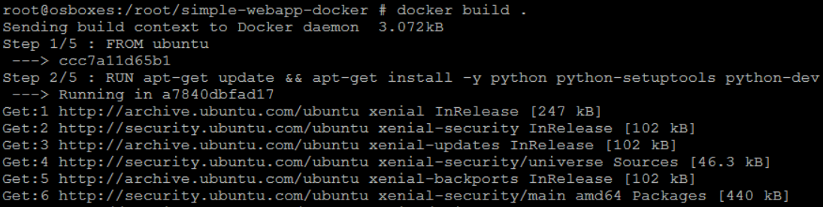
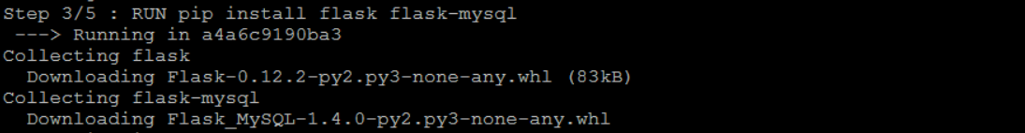
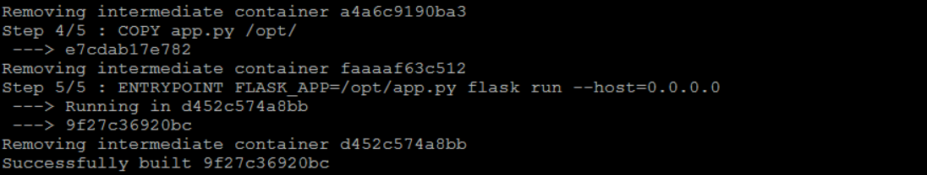
Docker build output
Notes:
When you run the docker build command you could see the various steps involved and the result of each task. All the layers built are cached so the layered architecture helps you restart Docker build from that particular step in case it fails or if you were to add new steps in the build process, so you don’t have to start all over again.

Slide 63
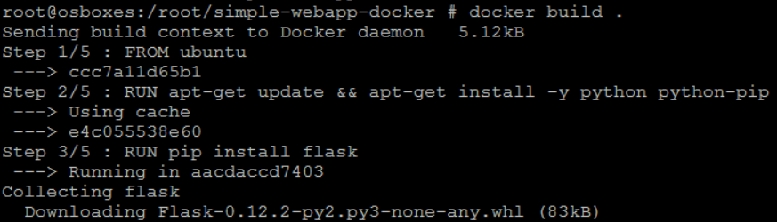
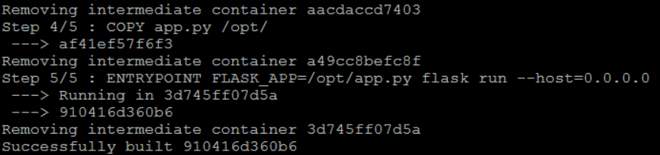
Failure
docker build Dockerfile –t mmumshad/my-custom-app
Layer 1. Base Ubuntu layer
Layer 2. Changes in apt packages
Layer 3. Changes in pip packages
Layer 4. Source code
Layer 5. Update Entrypoint with “flask” command
Notes:
All the layers built are cached by Docker. So, in case a particular step was to fail, for example in this case Step 3 failed and you were to fix the issue and re-run docker build, it will re-use the previous layers from cache and continue to build the remaining layers. The same is true if you were to add additional steps in the Dockerfile. This way rebuilding your image is faster and you don’t have to wait for Docker to rebuilt the entire image each time. This is helpful especially when you update source code of your application as it may change more frequently. Only the layers above the updated layers needs to be rebuild.

Slide 64



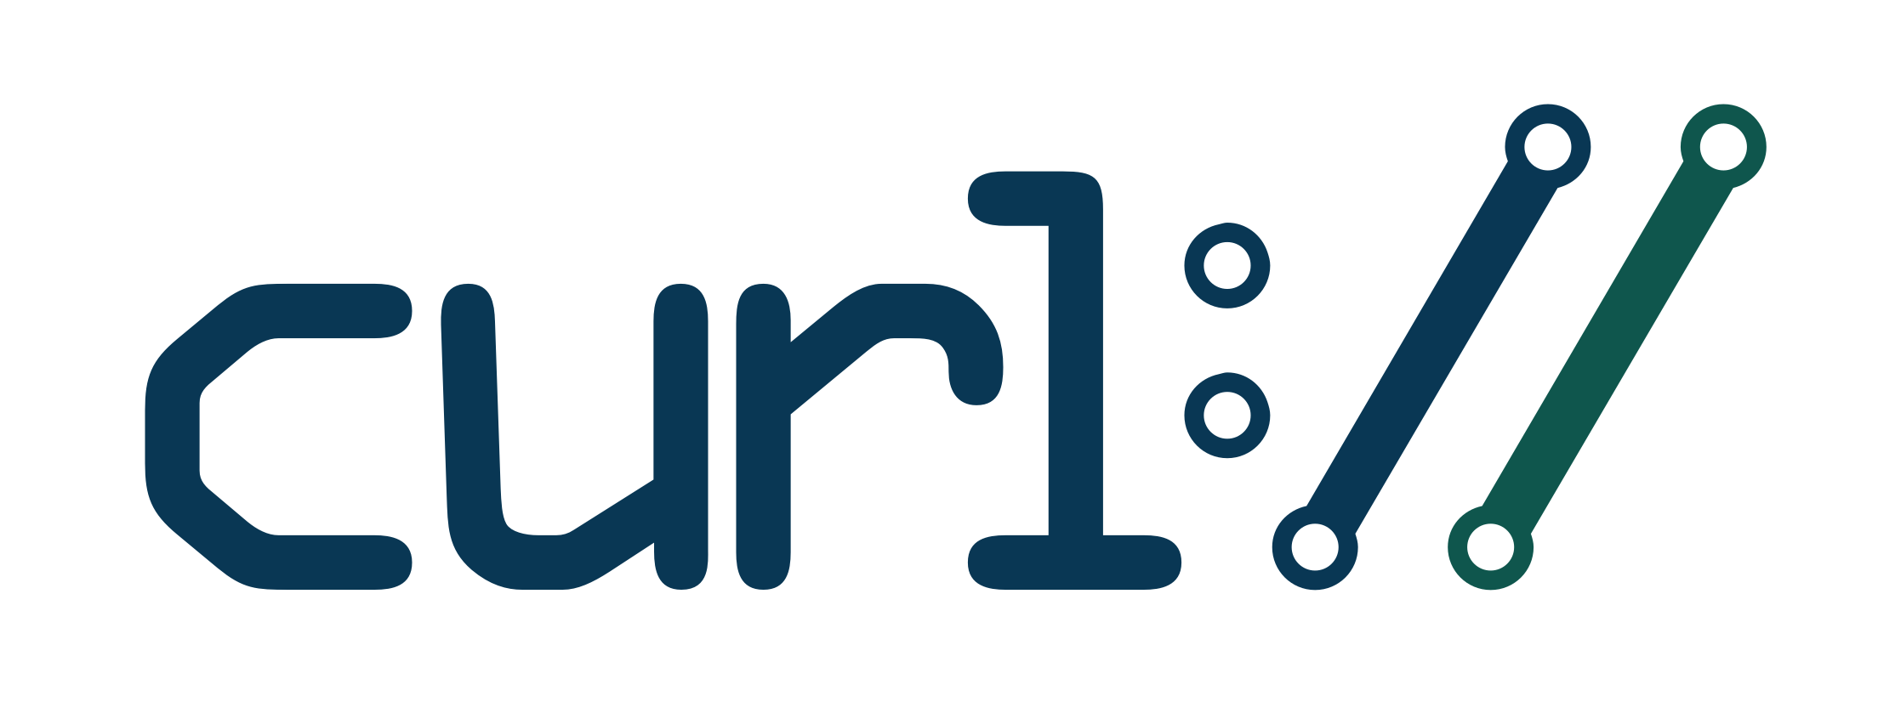
What Can You Containerize?
Containerize Everything!!!
Notes:
We just saw a number of products containerized. But that’s just not it. You can containerize almost all of the applications, even simple ones like a browsers, or utilities like curl, applications like Spotify, skype etc. Basically you can containerize anything and everything. And going forward I see that’s how everyone is going to run applications. Nobody is going to install anything anymore going forward. Instead they are just going to run it. And when they don’t need it anymore get rid of it.

Slide 65
It's time to do a hands-on lab on
Docker Images
Tap on this Link to access the lab

Slide 67
Docker
CMD vs Entrypoint
Notes:
We now look at some of the Docker commands. At the end of this lecture, you will go through a hands-on quiz where you will practice working with these commands.

Slide 68

docker run ubuntu
docker ps
CONTAINER ID IMAGE COMMAND CREATED STATUS PORTS
docker ps -a
CONTAINER ID IMAGE COMMAND CREATED STATUS PORTS
45aacca36850 ubuntu "/bin/bash" 43 seconds ago Exited (0) 41 seconds ago
Notes:
Let’s first refresh our memory on commands in containers and docker. We will then translate this into PODs in the next lecture. Let’s start with a simple scenario. <c> Say you were to run a docker container from an Ubuntu image. When you run the “docker run ubuntu” command, it runs an instance of Ubuntu image and exits immediately. <c> If you were to list the running containers you wouldn’t see the container running. <c> If you list all containers including those that are stopped, you will see that the new container you ran is in an Exited state. Now why is that?

Slide 69
Notes:
Unlike Virtual Machines, containers are not meant to host an Operating System. <c> Containers are meant to run a specific task or process. Such as to host an instance of a Web Server, or Application Server or a database or simply to carry out some kind of computation or analysis. <c> Once the task is complete the container exits. A container only lives as long as the process inside it is alive. If the web service inside the container is stopped or crashes the container exits.

Slide 70
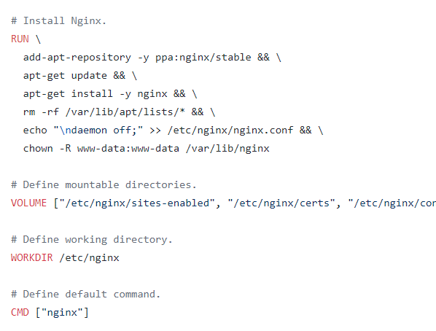
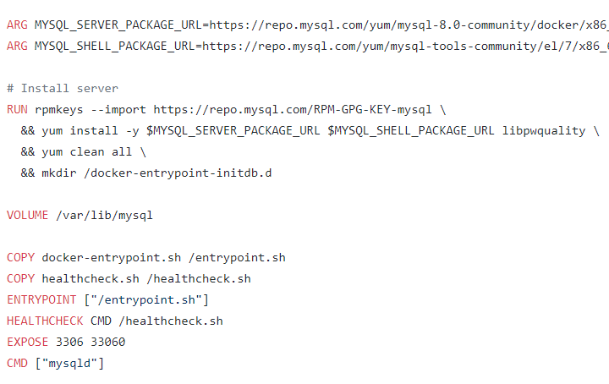
Notes:
So who defines what process is run within the container? <c> If you look at the Dockerfile for the NGINX image, <c> you will see an Instruction called CMD which stands for command that defines the program that will be run within the container when it starts. For the NGINX image it is the nginx command, <c> for the mysql image it is the mysqld command.

Slide 71
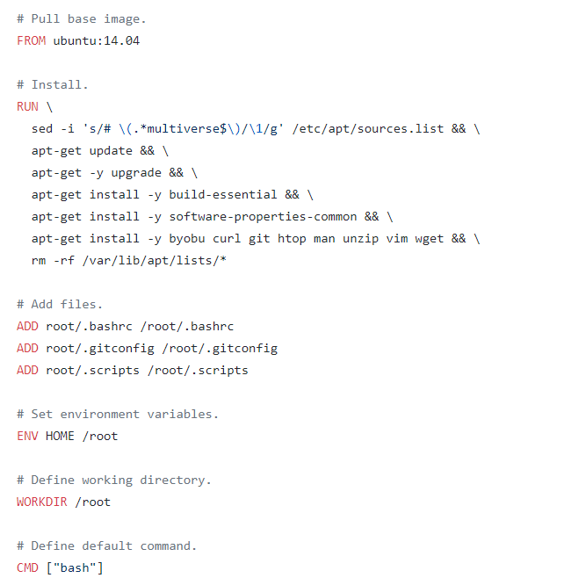
Notes:
What we tried to do earlier was to run a container with a plain Ubuntu Operating System. <c> Let us look at the Dockerfile for this image. You will see that it uses <c> “bash” as the default command. Now, bash is not really a process like a web server or database. It is a shell that listens for inputs from a terminal. If it cannot find a terminal it exits.

Slide 72
docker run ubuntu [COMMAND]
docker run ubuntu sleep 5
1
2
3
4
5
Notes:
So how do you specify a different command to start the container? <c> One option is to append a command to the docker run command and that way it overrides the default command specified within the image. In this case I run the docker run ubuntu command with the “sleep 5” command as the added option. This way when the container starts it runs the sleep program, waits for 5 seconds and then exits.

Slide 73


FROM Ubuntu
CMD sleep 5
CMD command param1
CMD sleep 5
CMD [“command”, “param1”]
CMD [“sleep”, “5”]
CMD [“sleep 5”]
docker build –t ubuntu-sleeper
1
2
3
4
5
docker run ubuntu-sleeper
Notes:
But how do you make that change permanent? Say you want the container to always run the sleep command when it starts.
<c> You would then create your own image from the base Ubuntu image and specify a new command.
<c> There are different ways of specifying the command. Either the command simply as is in a shell form. <c> Or in a JSON array format like this. But remember, when you specify in a JSON array format, the first element in the array should be the executable. In this case the sleep program. <c> Do not specify the command and parameters together like this. The first element should always be an executable.
<c> So I now build by new image using the docker build command, and name it as ubuntu-sleeper. I could now simply run the docker ubuntu sleeper command and get the same results. It always sleeps for 5 seconds and exits.

Slide 74
FROM Ubuntu
CMD sleep 5
docker run ubuntu-sleeper sleep 10
Command at Startup: sleep 10
FROM Ubuntu
ENTRYPOINT [“sleep”]
docker run ubuntu-sleeper 10
sleep
sleep
Command at Startup:
10
docker run ubuntu-sleeper
sleep: missing operand
Try 'sleep --help' for more information.
Command at Startup:
Notes:
But what if I wish to change the number of seconds it sleeps. Currently it is hardcoded to 5 seconds. As we learned before one option is to run the <c> docker run command with the new command appended to it. In this case sleep 10. <c> And so the command that will be run at startup will be sleep 10. But it doesn’t look very good. The name of the image ubuntu-sleeper in itself implies that the container will sleep. So we shouldn’t have to specify the sleep command again. Instead we would like it to be something like this. <c> Docker run ubuntu-sleeper 10. We only want to pass in the number of seconds the container should sleep and the sleep command should be invoked automatically.
<c> And that is where the entrypoint instruction comes into play. The entrypoint instruction is like the command instruction, as in you can specify the program that will be run when the container starts. And whatever you specify on the command line, in this case 10, will get appended to the entrypoint. <c> So the command that will be run when the container starts is sleep 10.
So that’s the difference between the two. In case of the CMD instruction the command line parameters passed will get replaced entirely, whereas in case of entrypoint the command line parameters will get appended.
<c> Now, in the second case what if I run the ubuntu-sleeper without appending the number of seconds? <c> Then the command at startup will be just sleep and you get the error that the operand is missing. So how do you add a default value as well?

Slide 75
FROM Ubuntu
ENTRYPOINT [“sleep”]
CMD [“5”]
docker run ubuntu-sleeper
sleep: missing operand
Try 'sleep --help' for more information.
sleep
sleep
5
Command at Startup:
docker run ubuntu-sleeper 10
Command at Startup:
10
docker run --entrypoint sleep2.0 ubuntu-sleeper 10
Command at Startup:
10
sleep2.0
Notes:
<c> That’s where you would use both Entrypoint as well as the CMD instruction. In this case the command instruction will be appended to the entrypoint instruction. So at startup, the command would be sleep 5, if you didn’t specify any parameters in the command line. <c> If you did, then that will override the command instruction. And remember, for this to happen, you should always specify the entrypoint and command instructions in a JSON format.
Finally, what if you really want to modify the entrypoint during run time? Say from sleep to a hypothetical sleep2.0 command? Well in that case you can override it by <c> using the --entrypoint option in the docker run command. The final command at startup would then be sleep2.0 10

Slide 76
It's time to do a hands-on lab on
Command vs Entrypoint
Tap on this Link to access the lab

Slide 78
Docker
Networking
Notes:
We now look at some of the Docker commands. At the end of this lecture, you will go through a hands-on quiz where you will practice working with these commands.

Slide 79
Default Networks
Bridge
None
Host
docker run ubuntu
docker run Ubuntu –-network=none
docker run Ubuntu --network=host
Docker Host
Docker Host
Docker Host
Web
Container
Web
Container
Web
Container
Web
Container
5000
5000
172.17.0.2
172.17.0.3
docker0
Web
Container
172.17.0.1
172.17.0.4
172.17.0.5
Web
Container
Web
Container
Notes:
When you install Docker, it creates three networks automatically – Bridge, Null and Host. Bridge is the default network a container gets attached to. <click> If you would like to associate the container with any other network specify the network information using the network command line parameter like this.
<click> The bridge network is a private internal network created by Docker on the host. All containers attach to this network by default and they get an internal IP address usually in the range 172.17 series. The containers can access each other using this internal IP if required. To access any of these containers from the outside world is to map ports of these containers to ports on the Docker host as we have seen before.
<click> Another way to access the containers externally is to associate the container to the host network. This takes out any network isolation between the docker host and the docker container. Meaning if you were to run a web server on port 5000 in a web app container it is automatically accessible on the same port externally without requiring any port mapping as the web container uses the host network. <click> This would also mean that unlike before you will now not be able to run multiple web containers on the same host on the same port as the ports are now common to all containers in the host network.
<click> With the none network the containers are not attached to any network and doesn’t have any access to the external network or other containers.

Slide 80
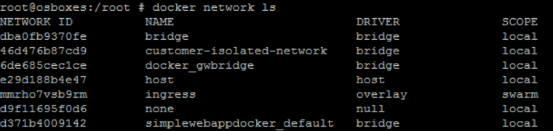
User-Defined Networks
Docker Host
Web
Container
Web
Container
docker network create \
–-driver bridge \
-–subnet 182.18.0.0/16
custom-isolated-network
172.17.0.2
172.17.0.3
182.18.0.3
docker0
docker0
172.17.0.1
182.18.0.1
172.17.0.4
182.18.0.2
172.17.0.5
docker network ls
Web
Container
Web
Container
Notes:
So we just saw the default bridged network, with the network ID 172.17.0.1. So all containers associated to this default network will be able to communicate to each other. But what if we wish to isolate the containers within the Docker host. For example the first two web containers on internal network 172 and the second two containers on a different internal network 182? By default Docker only creates one internal bridge network. For this we could create our own internal network using the command <click> docker network create and specify the driver which is bridge in this case and the subnet for that network followed by the custom-isolated network name.
<click> Run the docker network ls command to list all networks.

Slide 81
Inspect Network
docker inspect blissful_hopper
[
{
"Id": "35505f7810d17291261a43391d4b6c0846594d415ce4f4d0a6ffbf9cc5109048",
"Name": "/blissful_hopper",
"NetworkSettings": {
"Bridge": "",
"Gateway": "172.17.0.1",
"IPAddress": "172.17.0.6",
"MacAddress": "02:42:ac:11:00:06",
"Networks": {
"bridge": {
"Gateway": "172.17.0.1",
"IPAddress": "172.17.0.6",
"MacAddress": "02:42:ac:11:00:06",
}
}
}
]
Notes:
So how do we see the network settings and IP address assigned to an existing container? Run the docker inspect command with the id or name of the container and you will find a section on NetworkSettings. There you can see the type of network the container is attached to, its internal IP address, Mac Address and other settings.

Slide 82
Embedded DNS
Docker Host
mysql
web
Container
mysql
Container
mysql.connect( )
172.17.0.3
172.17.0.2
docker0
172.17.0.3
DNS Server
Host | IP
web | 172.17.0.2
mysql | 172.17.0.3
127.0.0.11
Notes:
Containers can reach each other using their names. For example, in this case I have a web server and a mysql database container running on the same node. How can I get my web server to access the database on the database container? <click> One thing I could do is to use the internal IP address assigned to the mysql container which in this case is 172.17.0.3. But that is not very ideal, because it is not guaranteed that the container will get the same IP when the system reboots.
The right way to do it is to use the container name. All containers in a Docker host can resolve each other with the name of the container. Docker has a built in DNS server that helps the containers to resolve each other using the container name. <click> Note that the built in DNS server always runs at address 127.0.0.11.
That’s all for now from this lecture on networking. Head over to the practice test and practice working with networking in Docker. I will see you in the next lecture.

Slide 83
It's time to do a hands-on lab on
Docker Networking
Tap on this Link to access the lab

Slide 85
Docker
Storage
Notes:
We will now look at storage in Docker.

Slide 86
File System
/var/lib/docker
aufs
containers
image
volumes
Notes:
Let us start with how Docker stores data on the host filesystem. When you install docker on a system, it creates this folder structure at /var/lib/docker. You have multiple folders under it called aufs, containers, image, volumes , …. Etc. This is where Docker stores all its data by default. When I say data I mean, files related to images and containers running on the Docker host. For example, all files related to containers are stored under the containers folder and the files related to images are stored under the image folder. Any volumes created by the Docker containers are created under the volumes folder. Well, don’t worry about that for now. We will come back to that in a bit. For now let’s just understand were docker stores its files and in what format.

Slide 87
Layered Architecture
Dockerfile
Dockerfile2
FROM Ubuntu
RUN apt-get update && apt-get –y install python
RUN pip install flask flask-mysql
COPY . /opt/source-code
ENTRYPOINT FLASK_APP=/opt/source-code/app.py flask run
FROM Ubuntu
RUN apt-get update && apt-get –y install python
RUN pip install flask flask-mysql
COPY app2.py /opt/source-code
ENTRYPOINT FLASK_APP=/opt/source-code/app2.py flask run
docker build Dockerfile –t mmumshad/my-custom-app
docker build Dockerfile2 –t mmumshad/my-custom-app-2
Layer 1. Base Ubuntu layer
120 MB
Layer 1. Base Ubuntu Layer
0 MB
Layer 2. Changes in apt packages
306 MB
Layer 2. Changes in apt packages
0 MB
Layer 3. Changes in pip packages
6.3 MB
Layer 3. Changes in pip packages
0 MB
Layer 4. Source code
229 B
Layer 4. Source code
229 B
Layer 5. Update Entrypoint
0 B
Layer 5. Update Entrypoint
0 B
Notes:
So, how exactly does docker store the files of an image and a container. To understand that we need to first understand Docker’s layered architecture. Let’s quickly recap something we learnt in the previous course. When docker builds images, it builds these in a layered architecture. Each line of instruction in the Dockerfile creates a new layer in the Docker image with just the changes from the previous layer. For example, the first layer is a base Ubuntu OS, followed by the second instruction that creates a second layer which installs all the apt packages, and then the third instruction creates a third layer with the python packages, followed by the 4th layer that copies the source code over and the final fifth layer that updates the entrypoint of the image.
<click> Since each layer only stores the changes from the previous layer, it is reflected in the size as well. If you look at the base Ubuntu image, it is around 120 MB in size. The apt packages that I install is around 300 MB, and the remaining layers are small.
<click> To understand the advantages of this layered architecture Let’s consider a second application. This application has a different Dockerfile, but is very similar to our first application. As in, it uses the base image as Ubuntu, uses the same python and flask dependencies. But uses a different source code to create a different application. And so a different entrypoint as well. When I run the docker build command to build a new image for this application, since the first three layers of both the applications are the same, Docker is not going to build the first 3 layers. Instead it re-uses the same three layers it built for the first application from the cache and only creates the last two layers with the new sources and the new entrypoint. This way Docker builds images faster and efficiently saves disk space. This is also applicable if you were to update your application code. Whenever you update your application code, such as the app.py in this case, docker simply re-uses all the previous layers from cache and quickly rebuilds the application image by updating the latest source code. Thus saving us a lot of time during rebuilds and updates.

Slide 88
Layered Architecture
Read Write
Container Layer
Layer 6. Container layer
docker run mmumshad/my-custom-app
Read Only
Layer 5. Update Entrypoint with “flask” command
Layer 4. Source code
Image Layers
Layer 3. Changes in pip packages
Layer 2. Changes in apt packages
Layer 1. Base Ubuntu layer
docker build Dockerfile –t mmumshad/my-custom-app
Notes:
Let’s re-arrange the layers bottom up so we can understand it better. At the bottom we have the base Ubuntu layer, then the packages, then the dependencies, then the source code and then the entry point to the application. All of these layers are created when we run the Docker build command to form the final Docker image. So all of these are the Docker Image Layers. Once the build is complete you cannot modify the contents of these layers, and so they are Read Only and you can only modify them by initiating a new build.
When you run a container based off of this image, using the docker run command, Docker creates a container based off of these layers and creates new writeable layer on top of the image layer. The writeable layer is used to store data created by the container such as log files written by applications, any temporary files generated by the container or just any file modified by the user. The life of this layer though is only as long as the container is alive. When the container is destroyed, this layer and all of the changes stored in it are also destroyed. Remember that the same image layer is shared by all containers created using this image.

Slide 89
COPY-ON-WRITE
Read Write
temp.txt
Container Layer
Read Only
app.py
app.py
Image Layers
Notes:
If I were to login to the newly created container and say create a new file called temp.txt, it will create that file in the container layer which is read write. We just said that the files in the image layer are read only. Meaning you can’t edit anything in those layers. Let’s take an example of our application code. Since we bake our code into the image, the code is part of the image layer and as such is read only. After running a container what if I wish to modify the source code to, say, test a change? Remember the same image layer may be shared by multiple containers created from this image. So does it mean I cannot modify this file inside the container? No. I can still modify this file. But before I save the modified file, Docker automatically creates a copy of the file in the read write layer and I will then be modifying a different version of the file in the read write layer. All future modifications will be done on this copy of the file in the read write layer. This is called Copy-On-Write mechanism. The image layer being read-only just means that the files in these layers will not be modified in the image itself. So the image will remain the same all the time, until you rebuild the image using the Docker build command.

Slide 90
Volumes
docker run –v data_volume:/var/lib/mysql mysql
docker volume create data_volume
docker run –v data_volume2:/var/lib/mysql mysql
/var/lib/docker
docker run –v /data/mysql:/var/lib/mysql mysql
volumes
docker run \
–-mount type=bind,source=/data/mysql,target=/var/lib/mysql mysql
data_volume
Docker Host
mysql-container layer
Read Write
Read Write
mysql-container layer
/var/lib/mysql
/var/lib/mysql
/var/lib/docker/volumes
/data
data_volume
mysql
mysql-image layer
Read Only
Notes:
What happens when we get rid of the container. All the data that was stored in the container layer also gets deleted. The change we made to the app.py and the new temp file we created will also get removed. So, what if we wish to persist this data? For example, if we were working with a database and we would like to preserve the data created by the container we could add a persistent volume to the container.
To do this, First create a volume using the docker volume create command. So when I run the doker volume create data_volume command, it creates a folder called data_volume under the /var/lib/docker/volumes directory. Then when I run the docker container using the docker run command I could mount this volume inside the docker containers read write layer using the –v option like this. So I would do a docker run –v then specify my newly created volume name, followed by a colon and the location inside my container, which is the default location were mysql stores data, and that is /var/lib/mysql and then the image name mysql. This will create a new container and mount the data_volume we created into /var/lib/mysql folder inside the container, so all data written by the database is infact stored on the volume created on the Docker host. Even if the container is destroyed the data is still active. Now what if you didn’t run the docker volume create command to create the volume before the docker run command. For example, if I run the docker run command to create a new instance of mysql container, with the volume data_volume2, which I have not created yet, Docker will automatically create a volume named data_volume2 and mount it to the container. You should be able to see all these volumes if you list the contents of the /var/lib/docker/volumes folder. This is Volume mounting as we are mounting a volume created by Docker under the /var/lib/docker/volumes folder. But what if we had our data already at another location – for example let’s say we have some external storage on the docker host mounted at /data and we would like to store database data on that volume and not in /var/lib/docker/volumes folder. In that case we would run a container using the command docker run –v but in this case we will provide the complete path to the folder we would like to mount that is /data/mysql and so it will create a container and mount the folder to the container. This is called as bind mounting. So there are two types of mounts – a volume mount and a bind mount. Volume mount mounts a volume from the volumes directory and bind mount mounts a directory from any location on the docker host.
One final point to note before I let you go. Using the –v is an old style. The new way is to use –mount. –mount is the preferred way as it is more verbose, so you have to specify each parameter in a key equals value format. For example, the previous command can be written with the –mount option as this, using the type, source and target options. The type in this case is bind, the source is the location on my host and target is the location on my container.

Slide 91
Storage Drivers
01
Overlay2
02
ZFS
03
BTRFS (Not recommended for production)
04
Device Mapper (Not commonly recommended)
05
AUFS (Deprecated)
06
Overlay (Deprecated)
Notes:
So, who is responsible for doing all of these operations? Maintaining the layered architecture, creating a write-able layer, moving files across layers to enable Copy-On-Write etc? It’s the storage drivers. So Docker uses storage drivers to implement the layered architecture. Some of the common storage drivers are BTRFS, ZFS, Device Mapper, overlay and overlay2. The selection of the storage driver depends on the underlying OS being used, for example, overlay2 is the preferred storage driver for all currently supported Linux distributions, and requires no extra configuration. In that case devicemapper may be a better choice. Docker will chose the best storage driver available automatically based on the operating system. The different storage drivers also provide different performance and stability characteristics. So you may want to chose one that fits the needs of your application and your organization. If you would like to read more on any of these storage drivers please refer to the links below. For now, that is all from Docker architecture concepts. See you in the next lecture.

Slide 92
It's time to do a hands-on lab on
Docker Storage
Tap on this Link to access the lab

Slide 94
Docker
Compose
Notes:
We now look at some of the Docker Compose. At the end of this lecture, you will go through a hands-on quiz where you will practice working with these commands.

Slide 95
Docker compose
docker run mmumshad/simple-webapp
docker run mongodb
docker run redis:alpine
docker run ansible
Public Docker registry – dockerhub
docker-compose.yml
services:
web:
image: “mmumshad/simple-webapp"
database:
image: “mongodb“
messaging:
image: "redis:alpine“
orchestration:
image: “ansible“
docker-compose up
Notes:
Let’s recap a few things real quick. In the beginner’s course we first learned how to run a Docker container using the docker run command. Then we learned that if we needed to setup a complex application running multiple services a better way to do it was to use docker compose. With docker compose we could create a configuration file in YAML format called docker-compose.yml and put together the different services and the options specific to running them in this file. Then we could simply run a docker-compose up command to bring up the entire application stack. This is easier to implement, run and maintain as all changes are always stored in the docker-compose configuration file. However this is all only applicable to running containers on a single Docker host. <pause> And for now, don’t worry about the yaml file. We will take a closer look at the yaml file in a bit and see how to put it together .

Slide 96
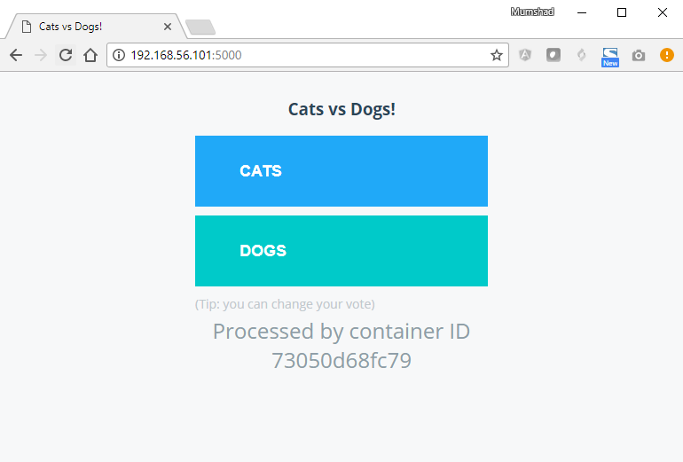
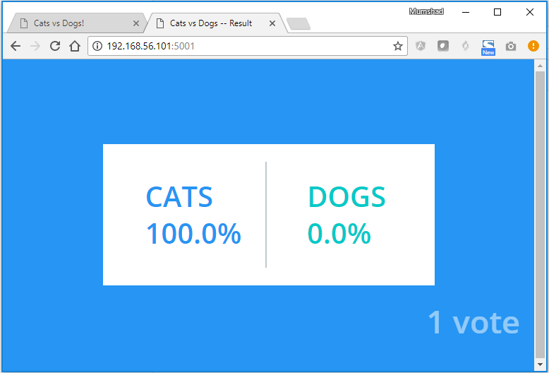
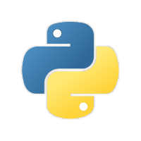




Sample Application – Voting Application
voting-app
result-app
python
NodeJS
C
in-memory DB
db
PostgreSQL
CATS | DOGS
0 | 0
Cats | Dogs
1 | 0
worker
.NET
Notes:
That was a real simple application that I put together. Let us look at a better example. I am going to use a voting application demonstrate Docker. It’s a simple application developed by Docker to demonstrate the various features available in running an application stack on Docker. So let’s first get familiarized with the application, because we will be working with the same application in different sections through the rest of the course. This is a sample voting application which provides on interface for a user to vote and another interface to show the results. The application consists of various components such as the voting-app, which is a web application developed in Python to provide the user with an interface to chose between two options – cat and a dog. When you make a selection, the vote is stored in redis. For those of you who are new to redis, redis in this case serves as a database in memory. This vote is then processed by the worker which is an application written in .Net. The worker application takes the new vote and updates the persistent database which is a Postgres SQL in our case. The Postgres SQL simple has a table with the number of votes for each category – cats and dogs. In this case it increments the number of votes for cats as our vote was for cats. Finally, the result of the vote is displayed in a web interface which is another web application developed in NodeJS. This resulting application reads the count of votes from the Postgres SQL database and displays it to the user. <pause> So that is the architecture and dataflow of this sample voting application stack.
As you can see this sample application is built with a combination of different services, different development tools and multiple different development platforms such as Python, Node.Js, .Net etc. This sample application will be used to showcase how easy it is to setup an entire application stack consisting of diverse components in Docker.

Slide 97
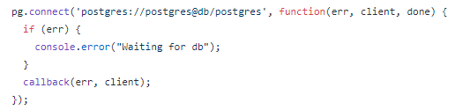
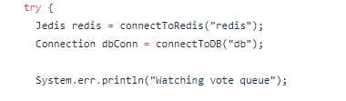
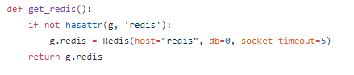
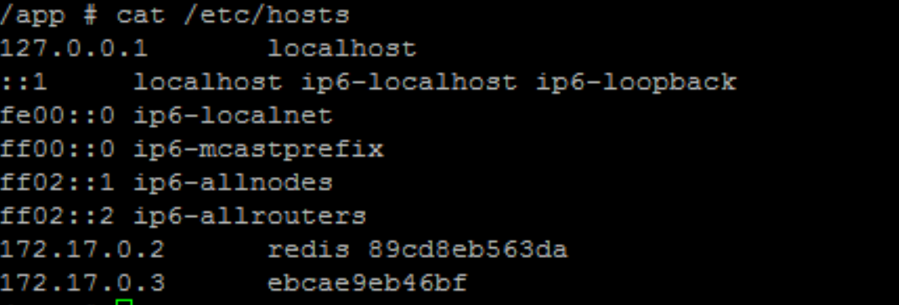
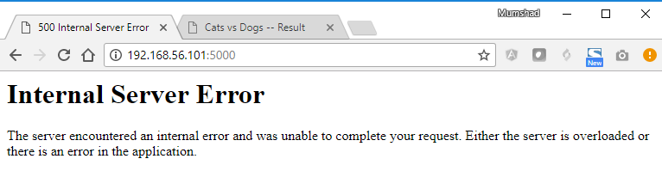
Docker Run
--links
docker run -d --name=redis redis
voting-app
result-app
docker run -d --name=db
--link redis:redis
voting-app
docker run -d --name=vote –p 5000:80
docker run -d --name=result –p 5001:80
--link db:db
result-app
in-memory DB
db
docker run -d --name=worker
worker
--link db:db --link redis:redis
worker
!
Deprecation Warning
Notes:
Let us keep aside Docker Swarm, services and stacks for a minute and see how we can put together this application stack on a single Docker Engine using, <pause> first docker run commands and then docker compose.
<click> Let us assume that all images of applications are already built and are available on Docker repository. Let us start with the data layer. First we run the docker run command to start an instance of redis by running the docker run redis command. We will add the –d parameter to run this container in the background and we will also name the container “redis”. Now, naming the containers is important. Why is that important? Hold that thought, we will come to that in a bit. Next, we will deploy the postgres sequel database by running the docker run postgres command. This time too we will add the –d option to run this in background and name this container “db” for database. Next we will start with the application services. We will deploy a front-end app for voting interface by running an instance of voting-app image. Run the docker run command and name the instance vote. Since this is a web server it has a web UI instance running on port 80. We will publish that port to 5000 on the host system, so we can access it from a browser. Next, we will deploy the result web application that shows the results to the user. For this we deploy a container using result-app image and publish port 80 to port 5001 on the host. This way we can access the Web UI of the resulting app on a browser. Finally, we deploy the worker, by running an instance of the worker image.
<pause> Sigh! Ok. Now this is all good and we can see all the instances running on the host. BUT, there is some problem though. It just does not seem to work. The problem is that we have successfully run all the different containers. But we haven’t actually linked them together. As in, we haven’t told the voting web application to use this particular redis instance. There could be multiple redis instances running. We haven’t told the worker and the resulting app to use this particular postgres sql database that we ran. So how do we do that? That is were we use links. Link is a command line option which can be used to link two containers together.
For example, the voting-app web service is dependent on the redis service. <click> When the web server starts, as you can see in this piece of code on the web server, it looks for a redis service running on host “redis”. But the voting-app container cannot resolve a host by the name redis. To make the voting-app aware of the redis service, we add a link option while running the voting-app container to link it to the redis container. Add a –link option to the docker run command and specify the name of the redis container, which in this case is redis, followed by a colon and the name of the host that the voting-app is looking for, which is also redis in this case. Remember that this is why we named the container when we ran it the first time, so we could use its name while creating a link. What this is in fact doing is, it creates an entry in the /etc/hosts file on the voting-app container adding an entry with hostname redis with the internal IP of the redis container.
Similarly we add a link for the result app to communicate with the database by adding a link option to refer the database by the name db. As you can see in the source code of the application, it makes an attempt to connect to a postgres database on host db.
Finally, the worker application requires access to both the redis as well as the postgres database. So we add two links to the worker application, one to link redis and the other to link postgres database.
<click> Note that using links this way is deprecated and the support may be removed in Docker in the future. This is because, as we will see in sometime, advanced and newer concepts in Docker swarm and networking supports better ways of achieving what we just did here with links. But I wanted to mention it anyway so you learn the concept from the very basics.

Slide 98
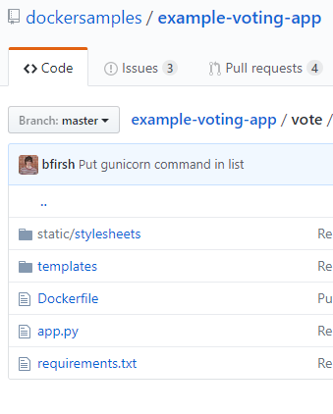
Docker compose – Build
docker-compose.yml
docker-compose.yml
redis:
image: redis
db:
image: postgres:9.4
vote:
image: voting-app
ports:
- 5000:80
links:
- redis
result:
image: result
ports:
- 5001:80
links:
- db
worker:
image: worker
links:
- db
- redis
redis:
image: redis
db:
image: postgres:9.4
vote:
build: ./vote
ports:
- 5000:80
links:
- redis
result:
build: ./result
ports:
- 5001:80
links:
- db
worker:
build: ./worker
links:
- db
- redis
Notes:
When we looked at the example of the sample voting application, we assumed that all images are already built. Out of the 5 different components, 2 of them – redis and postgres images – we know are already available on Docker hub. They are official images. But the remaining three are our own application. It is not necessary that they are already built and available in a docker registry. If we would like to instruct docker compose to run a docker build instead of trying to pull an image, we could replace the image line with a build line and specify the location of a directory which contains the application code and a Dockerfile with instructions to build the docker image. In this example, for the voting-app, I have all the application code in a folder named vote which contains all application code a Dockerfile. This time, when you run the docker-compose up command it will first build the images, give a temporary name for it, and then use those images to run containers using the options you specified before.
Similarly use build to build the two other services.

Slide 99
Docker compose – Versions
docker-compose.yml
docker-compose.yml
docker-compose.yml
services:
services:
redis:
image: redis
db:
image: postgres:9.4
vote:
image: voting-app
ports:
- 5000:80
version: 2
version: 3
redis:
image: redis
db:
image: postgres:9.4
vote:
image: voting-app
ports:
- 5000:80
links:
- redis
redis:
image: redis
db:
image: postgres:9.4
vote:
image: voting-app
ports:
- 5000:80
links:
- redis
depends_on:
- redis
version: 1
version: 2
version: 3
Notes:
We will now look at different versions of Docker Compose file. This is important because you might see docker compose files in different formats at different places and wonder why some look different. Docker compose evolved over time and now supports a lot more options than it did in the beginning. For example, this is the trimmed down version of docker-compose file we used earlier. This is infact the original version of Docker <click> compose file known as version 1. This had a number of limitations. For example, if you wanted to deploy containers on a different network other than the default bridged network, there was no way of specifying that. Also, say you have a dependency or startup order of some kind, for example your database container must come up first, and only then should the voting application be started, there was no way you could specify that.
Support for these came in Version 2. With version 2 and up, the format of the file changed a little bit. You no longer specify your stack information directly as you did before. It is all encapsulated in a services section. So create a property called services and then move all the services underneath that. You will still use the same docker-compose up command to bring up your application stack. But, how does docker-compose know what version of the file you are using? You are free to use version 1 or version 2 depending on your needs, so how does docker-compose know what format you are using? For version 2 and up you must specify the version of docker-compose file you are intending to use by specifying the version at the top of the file. In this case version: 2.
Another difference is with networking. In version 1, docker compose attaches all containers it runs to the default bridged network. And then you use links to enable communication between containers. With version 2, docker compose automatically creates a dedicated bridged network for this application and then attaches all containers to that new network. All containers are then able to communicate to each other using each others service name. So you basically don’t need to use links in version 2 of docker-compose.
And finally version 2 also introduces a depends_on feature. If we wish to specify a startup order, for instance say the voting web application is dependent on redis, so we need to ensure that redis container is started first, and only then the voting web application must be started. We could add a depends_on property to the voting application and indicate that it is dependent on redis.
Then came version 3 which is the latest as of today. Version 3 is similar to version 2 in the structure, meaning it has a version specification at the top and a services section under which you put all your services, just like in version 2. Make sure to specify the version number as 3 at the top. Version 3 comes with support for Docker Swarm which we will see later on. There are some options that were removed and added, to see details on those you could refer to the documentation section using the link in the reference page following this lecture. We will see Version 3 in much detail later when we discuss about Docker Stacks.

Slide 100

Docker compose
docker-compose.yml
version: 2
services:
redis:
image: redis
db:
image: postgres:9.4
vote:
image: voting-app
result:
image: result
front-end
voting-app
result-app
networks:
- back-end
networks:
- back-end
redis
db
networks:
- front-end
- back-end
back-end
networks:
- front-end
- back-end
worker
networks:
front-end:
back-end:
Notes:
Let us talk about networks in Docker Compose. Getting back to our application, so far we have been just deploying all containers on the default bridged network. Let us say we modify the architecture a little bit to contain traffic from different sources. For example, we would like to separate the user generated traffic from the applications internal traffic. So we create a front-end network dedicated for traffic from user and a back-end network dedicated for traffic within the application. We then connect the user facing applications, which are the voting-app and result-app to the front-end network and all the components to an internal backend network.
So back in our docker-compose file, note that I have actually stripped out the ports section for simplicity sake, the first thing we need to do, if we were to use networks is to define the networks we are going to use. In our case we have two networks – front-end and back-end. So create a new property called networks at the root level adjacent to services, and add a map of networks we are planning to use. Then under each service create a networks property and provide a list of networks that service must be attached to. In case of redis and db, its only the back-end network. In case of the front-end applications, they require to be attached to both vote and result. You must also add a section for worker container to be added to the back-end network. I have omitted that in this slide due to space contraints. ;-)

Slide 101
It's time to do a hands-on lab on
Docker Compose
Tap on this Link to access the lab

Slide 103
Docker
Registry
Notes:
Let us now look at some registry commands.

Slide 104
Image
docker run nginx
nginx-pod.yaml
apiVersion: v1 kind: Pod metadata: name: nginx-pod spec: containers: - name: nginx image:
Notes:
Let’s look at a simple nginx container. We run the docker run nginx command to run an instance of the nginx image.

Slide 105
Image
docker.io
Docker Hub
image:
docker.io/
nginx/
nginx
Registry
User/
Account
Image/
Repository
gcr.io/
kubernetes-e2e-test-images/dnsutils
Notes:
Since we have not specified the location where these images are to be pulled from, it is assumed to be on docker’s default registry – dockerhub. The dns name for which is docker.io. The registry is where all the images are stored. Whenever you create a new image or update an image, you push it to the registry and every time anyone deploys this application it is pulled from the registry. There are many other popular registries as well.
Google’s <c> registry was previously at gcr.io, and currently this has been deprecated and serving from artifact registry. Check the reference link for more upto date information.
Reference : https://cloud.google.com/container-registry/docs/deprecations/container-registry-deprecation
These are all publicly accessible images, that anyone can download and access. When you have applications built in-house that shouldn’t be made available to the public, hosting an internal private registry may be a good solution. Many cloud service providers such as AWS, Azure or GCP provide a private registry by default when you open an account with them.

Slide 106
Private Registry
docker login private-registry.io
Login with your Docker ID to push and pull images from Docker Hub. If you don't have a Docker ID, head over to https://hub.docker.com to create one.
Username: registry-user
Password:
WARNING! Your password will be stored unencrypted in /home/vagrant/.docker/config.json.
Login Succeeded
docker run private-registry.io/apps/internal-app
nginx-pod.yaml
apiVersion: v1 kind: Pod metadata: name: nginx-pod spec: containers: - name: nginx image:
Notes:
On any of these solutions, be it on Docker hub or googles registry, or your internal private registry, you may chose to make a repository private, so that it can only be accessed using a set of credentials.
From Docker’s perspective to run a container using an image from a private registry, you first login to your private-registry using the docker login command. Input your credentials. Once successful run the application using private-registry as part of the image name like this.
If you did not login to the private registry, it will say that the image cannot be found. So remember to always login before pulling or pushing to a private registry.

Slide 107
Deploy Private Registry
docker run -d -p 5000:5000 --name registry registry:2
docker image tag my-image localhost:5000/my-image
nginx-pod.yaml
apiVersion: v1 kind: Pod metadata: name: nginx-pod spec: containers: - name: nginx image:
docker push localhost:5000/my-image
docker pull localhost:5000/my-image
docker pull 192.168.56.100:5000/my-image
Notes:
We said that cloud providers like AWS or GCP provide a private registry when you create an account with them. But what if you are running your application on premise and don’t have a private registry? How do you deploy your own private registry within your organization? The Docker registry is itself another application and of course is available as a docker image. The name of the image is registry. And it exposes the API on port 5000.
Now that you have your custom registry running at port 5000 on this docker host, how do you push your own image to it? Use the docker image tag command to tag the image with the private registry url in it. In this case since its running on the same docker host I can use localhost semicolon 5000, followed by the image name.
I can then push my image to my local private registry using the command docker push and the new image name with the registry information in it.
From there on, I can pull my image from anywhere within this network using either localhost if you are on the same host, or the IP or domain name of my docker host, if I am accessing from another host in my environment.

Slide 108
It's time to do a hands-on lab on
Docker Registry
Tap on this Link to access the lab

Slide 110
Docker
Engine
Notes:
We now look at some of the Docker commands. At the end of this lecture, you will go through a hands-on quiz where you will practice working with these commands.

Slide 111
Docker Engine
Docker Engine
Laptop
Docker CLI
REST API
Docker Deamon
docker -H=remote-docker-engine:2375
docker -H=10.123.2.1:2375 run nginx
Notes:
Docker Engine as we have learned before is simply referred to the host with Docker installed on it. When you install Docker on a Linux host, you are actually installing 3 different components. The Docker Deamon, the Rest API server and the Docker CLI. The docker deamon is a background process that manages Docker objects such as the images, containers, volumes and networks. The Docker Rest API server is the API interface that programs can use to talk to the deamon and provide instructions. You could create your own tools using this REST API. And the docker cli is nothing but the command line interface that we have used before to perform actions such as running a container, stopping containers, destroying images etc. It uses the REST API to interact with the Docker Deamon.
Something to note here is that the Docker CLI need not necessarily be on the same host. It could be on another system, like a laptop and can still work with a remote Docker Engine. Simply use the –H option on the docker command and specify the remote docker engine address and a port as shown here. For example, to run a container based on nginx on a remote docker host, run the command docker –H=10.123.2.1 <colon> 2375 run nginx.

Slide 112
Containerization
Process ID
Unix Timesharing
Namespace
Network
Mount
InterProcess
Notes:
Now let’s try and understand how exactly are applications containerized in Docker? How does it work under the hoods? Docker uses namespaces to isolate workspace. Process IDs, Network, InterProcess Communication, Mounts and Unix Timesharing Systems are created in their own namespace there by providing isolation between containers

Slide 113
Namespace – PID
Linux System
PID : 1
PID : 2
PID : 3
Child System (Container)
PID : 4
PID : 5
PID : 1
PID : 6
PID : 2
Notes:
Let’s take a look at one of the name space isolation technique – Process ID namespaces. Whenever a Linux system boots up, it starts with just one process with a process ID of 1. This is the root process and kicks off all the others processes in the system. By the time the system boots up completely, we have a handful of processes running. This can be seen by running the ps command to list all the running processes. The process IDs are unique and two processes cannot have the same process ID. Now, if we were to create a container, which is basically like a child system within the current system, the child system needs to think that it is an independent systems on its own and has its own set of processes originating from a root process with a process ID of 1. But we know that there is no hard isolation between the containers and the underlying host, so the processes running inside the container are infact running on the underlying host and so two processes cannot have the same process ID of 1. This is were namespaces come into play. With process ID namespaces, each process can have multiple processes ID’s associated with it. For example, when the processes start in the container, its actually just another set of processes on the base linux system and it gets the next available process ID. In this case 5 and 6. However they also get another process ID starting with PID 1 in the container namespace which is only visible inside the container. So the container thinks that it has its own root process tree and so it is an independent system. <pause>
So how does that relate to an actual system? How do you see this on a host? Let’s say I were to run an NGINX server as a container. We know that the NGINX container runs an nginx service. If we were to list all services inside the docker container, we see the nginx service running with a process ID of 1. This is the process ID of the service inside of the container namespace. If we list the services on the Docker host, we will see the same service, but with a different process ID – in this case <something else>. That indicates that all process are infact running on the same host, but separated into their own containers using namespaces.

Slide 114
cgroups
Linux System
Docker Container
Docker Container
Docker Container
CPU
Memory
docker run --cpus=.5 ubuntu
docker run --memory=100m ubuntu
Notes:
So we learnt that the underlying Docker host as well as the containers share the same system resources, such as the CPU and Memory. How much of the resources are dedicated to the host and the containers and how does Docker manage and share the resources between the containers? By default, there is no restriction as to how much of a resource a container can use. And hence a container may end up utilizing all of the resources on the underlying host. But there is a way to restrict the amount of CPU or memory a container can use. Docker uses CGROUPS or Control Groups to restrict the amount of hardware resources allocated to each container.
This can be done by providing the - -cpus option to the docker run command. Providing a value of .5 will ensure that the container does not take up more than 50% of the host CPU at any given time. The same goes with memory, setting a value of 100m to the –memory option limits the amount of memory the container can use to a 100 megabytes.
If you are interested in reading more on this topic, refer to the links I posted in the reference page. That’s it for now on Docker Engine, in the lecture we talk about other advanced topics on Docker storage and filesystems. See you in the next lecture.

Slide 116
Docker
On Windows
Notes:
We now look at some of the Docker commands. At the end of this lecture, you will go through a hands-on quiz where you will practice working with these commands.

Slide 117
Docker on Windows
01
Docker on Windows using Docker Toolbox
02
Docker Desktop for Windows
Notes:
Earlier in this course we learned that containers share the underlying OS Kernel and as a result we cannot have a windows container running on Linux hosts or vice versa. We need to keep this in mind, while going through this lecture. As it’s a very important concept and most beginners tend to have an issue with it.
So what are the options available for Docker on windows? There are two options available. The first one is Docker on Windows using Docker Toolbox. The second one is the Docker Desktop for Windows option. We will look at each of these now.

Slide 118

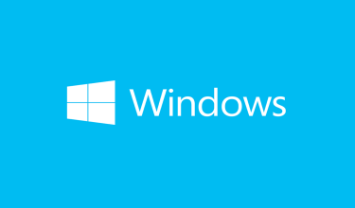
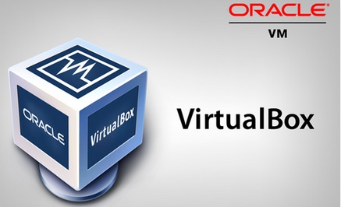
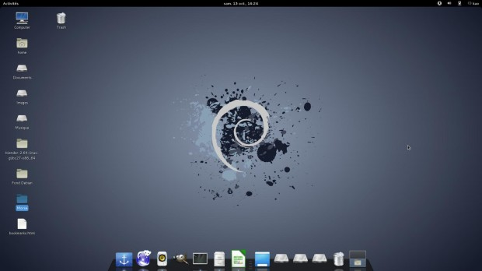
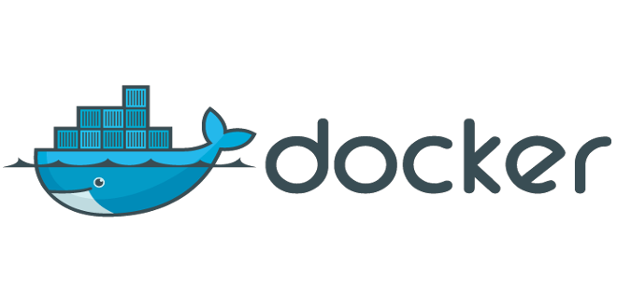
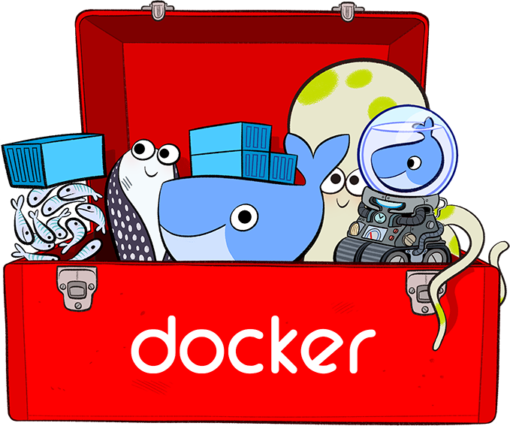
1. Docker Toolbox
64-bit operating
Windows 7 or higher.
Virtualization is enabled
Oracle Virtualbox
Docker Engine
Docker Machine
Docker Compose
Kitematic GUI
Docker Quickstart Terminal App
Notes:
Let’s look at the first option – Docker Toolbox. This was the original support for Docker on Windows. Imagine that you have a windows laptop, and no access to any linux system whatsoever. But you would like to try Docker. You don’t have access to a linux system in the lab, or in the cloud. What would you do? What I did was to install a virtualization software on my windows system like Oracle Virtualbox or VMWare Workstation and deploy a linux VM on it such as Ubuntu or Debian. Then install Docker on the linux VM and play around with it. This is what the first option really is about. It doesn’t really have anything much to do with Windows. You cannot create windows based docker images, or run windows based docker containers. You obviously cannot run linux container directly on windows either. You are just working with Docker on a linux virtual machine on a windows host. <click> Docker however provides us with a set of tools to make this easy which is called as The Docker toolbox. Docker Toolbox contains the following tools: Docker Machine, Docker Engine, Docker Compose, Kinematic, Docker Quickstart Terminal App, Oracle VirtualBox. This will help you get started by simply downloading and running the docker toolbox executable. It will install Virtualbox, deploy a lightweight VM, called boot2docker which has Docker running in it already so that you are all set to start with Docker easily and within a short period of time.
What about requirements? You must ensure that your operating system is 64-bit, windows 7 or higher and that virtualization is enabled on the system.
Reference: https://docs.bitnami.com/containers/how-to/install-docker-in-windows/
Remember, Docker Toolbox is legacy solution for older Windows systems, that do not meet the requirements for Docker for Windows.
<pause>

Slide 119
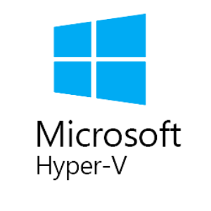
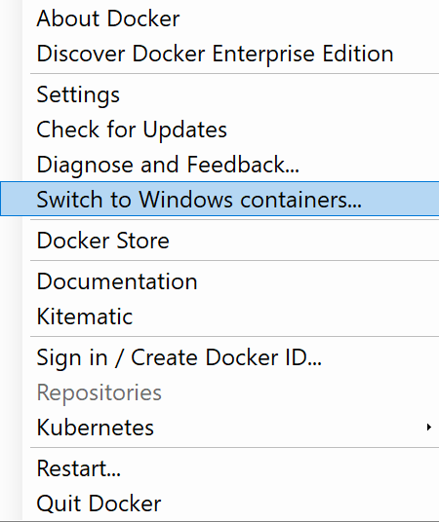
2. Docker Desktop for Windows
Support: Windows 10 Enterprise/Professional Edition
Windows Server 2016
Linux Containers (Default)
Or
Windows Containers
Notes:
The second option is the newer option called Docker For Windows. In the previous option we saw that we had Oracle Virtualbox installed on Windows, and then a Linux system and then Docker on that Linux System. Now, with Docker for Windows, we take out Oracle Virtualbox and use the native virtualization technology available with Windows called Microsoft Hyper-V. During the installation process for Docker for Windows, it will still automatically create a Linux system underneath, but this time it is created on the Microsoft Hyper-V instead of Oracle Virtual box and have Docker running on that system. Because of this dependency on Hyper-V this options is only supported for Windows 10 Enterprise/Professional edition and on Windows Server 2016. Because both these Operating systems comes with Hyper-V support by default.
Now here’s the most important point. So far whatever we have discussed with Docker’s support for windows, it is strictly for Linux containers. Linux applications packaged into Linux docker images. We are not talking about windows applications or windows images or widows containers. Both the options we just discussed will help you run a linux container on a windows host.
With windows server 2016, Microsoft announced support for Windows containers for the first time. You can now package windows applications, into windows docker containers and run them on a windows docker host using Docker for Windows.
<c> When you install Docker For Windows the default option is to work with Linux containers. <c> But if you would like to run windows containers, then you must explicitly configure Docker for windows to switch to using windows containers.

Slide 120
Windows Containers
Container Types:
Windows Server
Hyper-V Isolation
Container
Container
Container
Container
Container
Container
Kernel
Kernel
Kernel
Kernel
Kernel
Base Images:
Windows Server Core
Nano Server
Support
Windows Server 2016
Nano Server
Windows 10 Professional and Enterprise (Hyper-V Isolated Containers)
Notes:
In early 2016 Microsoft announced Windows Containers. Now you could create windows based images and run windows containers on a Windows Server just like how you would run Linux containers on a Linux system. You can create windows images, containerize your applications, and share them through the Docker Store.
Unlike in Linux, there are two types of containers in windows. First on is a Windows Server container, which works exactly like Linux containers were the OS Kernel is shared with the underlying operating system. To allow better security boundary between containers and to allow kernels with different versions and configurations, the second option was introduced known as the Hyper-V Isolation. With Hyper-V Isolation each container is run within a highly optimized virtual machine guaranteeing complete kernel isolation between the containers and underlying host.
<click>
Now, while in the Linux world you had a number of base images for linux systems such as Ubuntu, Debian, Fedora, alpine etc. if you remember that is what you specify at the beginning of a Dockerfile, in the windows world we have two options: Windows Server Core and Nano Server. A Nano server is a headless deployment option for Windows Server, which runs at a fraction of the size of the full operating system. You can think of this like Alpine image in Linux. The windows server core though is not as light weight as you might expect it to be.
<click>
Finally Windows containers are supported on Windows Server 2016, Nano Server and Windows 10 Professional and Enterprise Edition. Remember, on windows 10 Profession and Enterprise edition only supports Hyper-V Isolated containers. Meaning, as we just discussed, every container deployed is deployed on a highly optimized virtual machine.

Slide 121
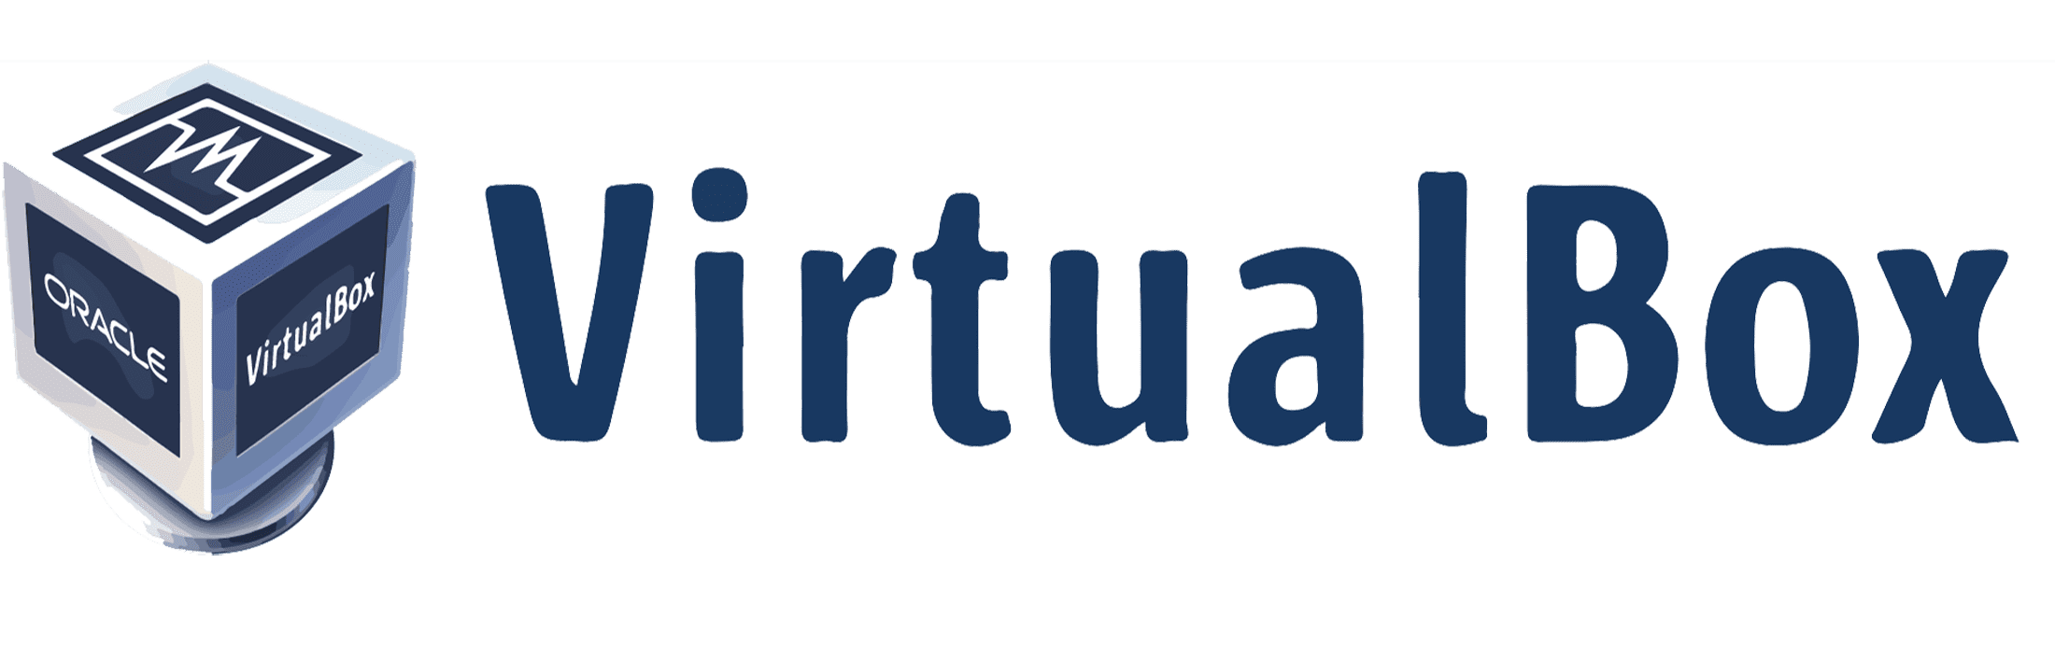
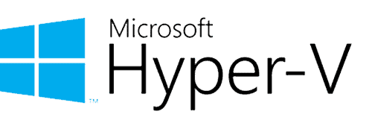
VirtualBox or Hyper-V
Windows
Notes:
Well that’s about it on Docker on Windows. Before I finish I want to point out one important fact. We saw two ways of running a docker container using VirtualBox or Hyper-V. But remember VirtualBox and Hyper-V cannot co-exist on the same windows host. So if you started off with Docker Toolbox with VirtualBox, and if you plan to migrate to Hyper-V, remember you cannot have both solutions at the same time. There is migration guide on Docker documentation page on how to migrate from VirtualBox to Hyper-V.

Slide 123
Docker
On Mac
Notes:
We now look at Docker on Mac. Docker on MAC is similar to Docker on Windows.

Slide 124
Docker on Mac
01
Docker on Mac using Docker Toolbox
02
Docker Desktop for Mac
Notes:
There are 2 options to get started. Docker on MAC using Docker Toolbox or Docker Desktop for Mac option.

Slide 125
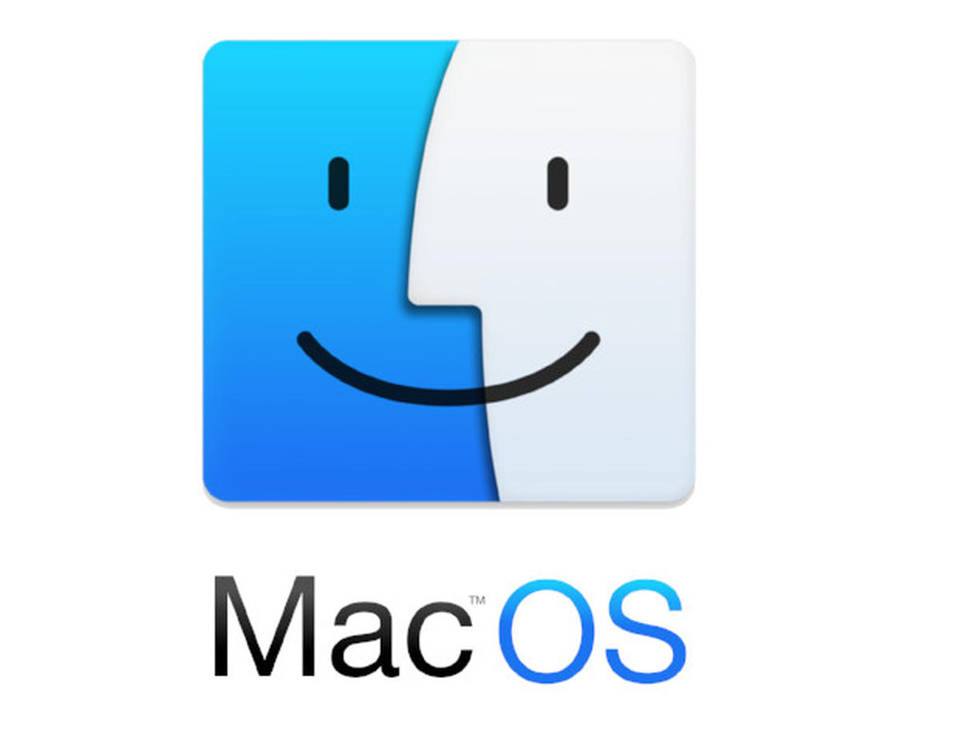
1. Docker Toolbox
macOS 10.8 “Mountain Lion” or newer
Oracle Virtualbox
Docker Engine
Docker Machine
Docker Compose
Kitematic GUI
Notes:
Let’s look at the first option – Docker Toolbox. This was the original support for Docker on Mac. It is docker on a Linux VM created using VirtualBox on MAC. As with windows it has nothing to do with mac applications, or mac based images or mac containers. Its purely to run linux containers on a MAC OS.
Docker Toolbox contains the following tools:
Docker Machine
Docker Engine
Docker Compose
Kinematic
Docker Quickstart Terminal App
Oracle VirtualBox
This requires macOS 10.8 or newer.
<pause>

Slide 126

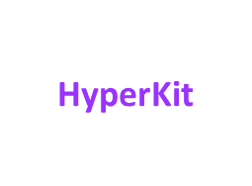
2. Docker Desktop for Mac
Support: macOS Sierra 10.12 or newer
Mac Hardware - 2010 model or newer
Linux Containers
Notes:
The second option is the newer option called Docker Desktop For Mac. With Docker Desktop for Mac, we take out Oracle Virtualbox and use HyperKit virtualization technology. During the installation process for Docker for Windows, it will still automatically create a Linux system underneath, but this time it is created on HyperKit instead of Oracle Virtual box and have Docker running on that system. This requires macOS Sierra 10.12 or newer. And the Mac hardware must be 2010 or newer model.
Finally remember that all of this is to be able to run linux container on MAC. As of this recording, there are no MAC based images or containers.
Well that’s it with Docker on Mac for now.

Slide 128
Orchestration
Container
Notes:
We now look at some of the Docker commands. At the end of this lecture, you will go through a hands-on quiz where you will practice working with these commands.

Slide 129


Why Orchestrate?
docker run nodejs
docker run nodejs
docker run nodejs
docker run nodejs
Public Docker registry – dockerhub
Notes:
So far in this course, we have seen that with Docker, you can run a single instance of the application with a simple docker run command.
In this case to run a nodejs application you run the docker run nodejs command. But that’s just one instance of your application on one docker host. What happens when the number of uses increase and that instance is no longer able to handle the load? You deploy additional instance of your application by running the docker run command multiple times. So that’s something you have to do yourself. You have to keep a close watch on the load and performance of your application and deploy additional instances yourself.
Not just that, you have to keep a close watch on the health of these containers. And if a container was to fail, you should be able to detect that, and run the docker run command again to deploy another instance of that application. What about the health of the Docker host itself? What if the host crashes and is inaccessible? The containers hosted on that host become accessible too.
So what do you do in order to solve these issues? You will need a dedicated engineer who can sit and monitor the state , performance and health of the containers and take necessary actions to remediate the situation. But when you have large applications deployed with 10’s of 1000s of containers that’s not a practical approach. So you can build your own scripts that will help you do these.

Slide 130
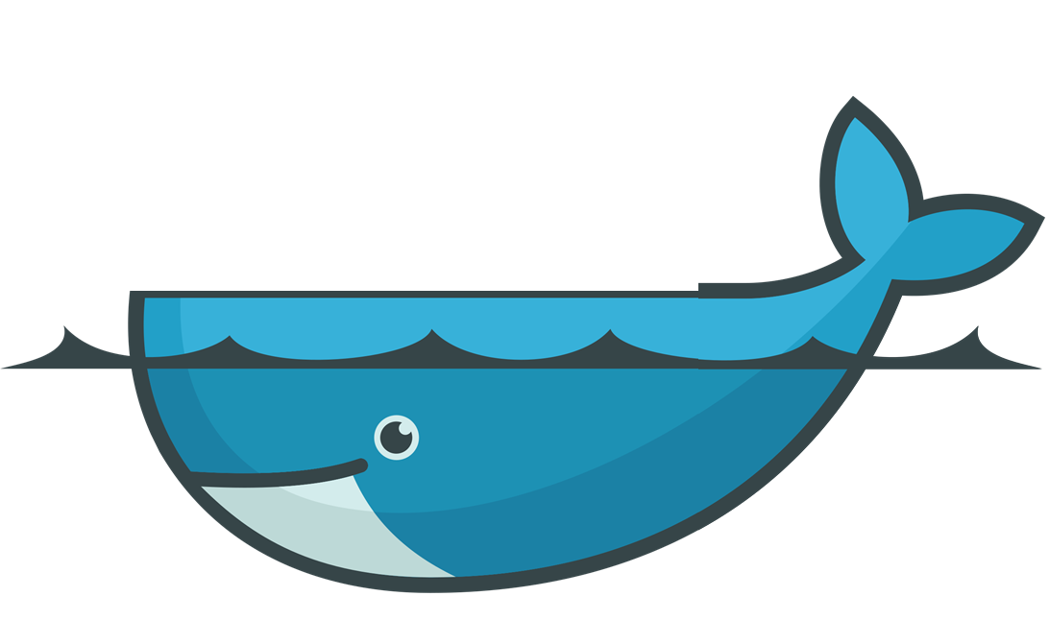
Container Orchestration
docker service create -–replicas=100 nodejs
Notes:
Container orchestration does just that. It is a solution that consists of a set of tools and scripts that can help host containers in a production environment.
Typically a container orchestration solution consists of multiple docker hosts that can host containers. That way even if one fails, the application is still accessible through the others.
<c>
A container orchestration solution easily allows you to deploy 100s or 1000s of instances of your application with a single command. This is a command used for Docker Swarm. We will look at the command itself in a bit.
Some orchestrations solutions can help in automatically scaling up the number of instances when users increase and scaling it down when the demand decreases.

Slide 131

Container Orchestration
docker service create -–replicas=100 nodejs
Notes:
Some solutions help in automatically adding additional hosts to support user load.
And not just clustering and scaling, the container orchestration solutions also provide support for advanced networking between these containers across different hosts. Load balancing user requests across different hosts. They also provide support for sharing storage between the hosts. As well as support for configuration management and security within the cluster.

Slide 133
Docker
Swarm
Notes:
We will now get a quick introduction to Docker Swarm. Docker swarm has a lot of concepts to cover and requires its own course. But we will take a quick to look at some of the basic details so you get a brief idea on what it is.

Slide 134
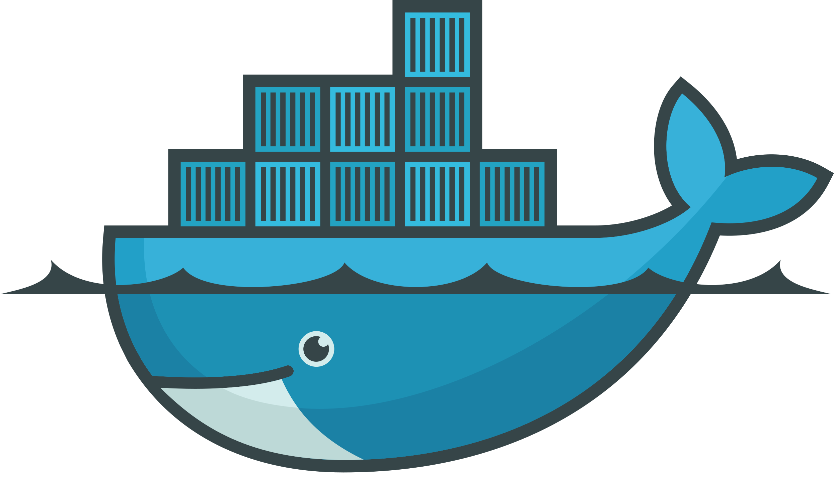




Solutions
Docker Swarm
Notes:
There are multiple container orchestration solutions available today – Docker has Docker Swarm. Kubernetes from Google and Mesos from Apache. While Docker Swarm is really easy to setup and get started, it lacks some of the advanced autoscaling features required for complex production grade applications. Mesos on the other hand is quite difficult to setup and get started, but supports many advanced features. Kubernetes - arguably the most popular of it all – is a bit difficult to setup and get started but provides a lot of options to customize deployments and has support from many different vendors. Kubernetes is now supported on all public cloud service providers like GCP, Azure and AWS and the kubernetes project is one of the top ranked projects on Github.
In the upcoming lectures we will take a quick look at Docker Swarm and Kubernetes.

Slide 135
Docker Swarm
Docker Swarm
Docker Host
Docker Host
Docker Host
Docker Host
Web
Container
Web
Container
Web
Container
Web
Container
Web
Container
MySQL
Container
Notes:
In the previous lecture, we discussed that running your containers on a single Docker host may be good for dev/test purposes, but in a production setup this may not be a good idea as this is a single point of failure. If the underlying host fails, we lose all the containers and our application goes down.
This is were Docker Swarm comes into play. <click> With Docker swarm you could now combine multiple Docker Machines together into a single cluster. Docker swarm will take care of distributing your services into separate hosts for high availability and for balancing load across different systems and hardware.

Slide 136
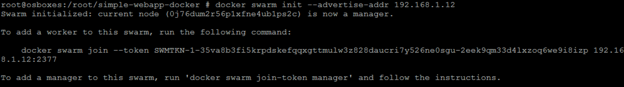
Set Up Swarm
Node
Node
Node
Swarm Manager
Worker
Worker
Worker
Docker Host
Docker Host
Docker Host
Docker Host
docker swarm init
docker swarm join
--token <token>
docker swarm join
--token <token>
docker swarm join
--token <token>
Notes:
We also discussed how to setup Docker swarm. First you must have hosts with Docker installed on them. Then you must designate one host to be the master or the Swarm Manager and others as slaves or workers. Once you are done with that run the “docker swarm init” command on the swarm manager and that will initialize the swarm manager. The output will also provide the command to be run on the workers. Copy the command and run it on the worker nodes to join the manager. After joining the swarm, the workers are also referred to as nodes and you are now ready to create services and deploy them on the swarm cluster. Let’s get into some more details.

Slide 137
Docker service
docker service create -–replicas=3 –-network frontend my-web-server
docker service create -–replicas=3 –p 8080:80 my-web-server
docker run my-web-server
docker service create -–replicas=3 my-web-server
Docker Swarm
Docker Host
Worker Node
Worker Node
Worker Node
Web Server
Web Server
Web Server
Web Server
Notes:
As you already know, to run an instance of my-web-server I run the Docker run command and specify the name of the image I wish to run. This creates a new container instance of my application and serves my web server. Now that we have learnt how to create a swarm cluster, how do I utilize my cluster to run multiple instances of my web server? One way to do this would be to run the docker run command on each worker node. But that is not ideal as I might have to login to each node and run this command, and there could be 100s of nodes. I will have to setup load balancing myself, I will have to monitor the state of each instance myself, and if instances were to fail, restart them myself. So its going to be an impossible task. That is were Docker Swarm orchestration comes into play. Docker Swarm Orchestrator does all of this for us. So far we have only setup the swarm cluster, but we haven’t seen orchestration in action. The key component of Swarm orchestration is Docker Service. Docker services are one or more instances of a single application or service that runs across the Swarm Cluster. For example, in this case I could create a docker service to run multiple instances of my-web-server application across worker nodes in my swarm cluster. For this I run the docker service create command on the manager node and specify my image name, which is my-web-server in this case and use the option replicas to specify the number of instances of my-web-server I would like to run across the cluster. Since I specified 3 replicas I get 3 instances of my-web-server distributed across worker nodes. Remember, the docker service command must be run on the manager node and not on the worker node. The Docker service create command is similar to the docker run command in terms of the options passed such as –e environment variables, -p for publishing ports, --network to attach container to a network etc.
Well, that’s a high level introduction to Docker Swarm. There is a lot more to know such as configuring multiple managers, overlay networks, As I mentioned it requires it’s own separate course.

Slide 139
Kubernetes
Notes:
We will now get a brief introduction to basic kubernetes concepts. Again kubernetes requires its own course, well a few courses. Atleast 5. But we will try to get a brief introduction to it here.

Slide 140
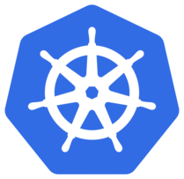
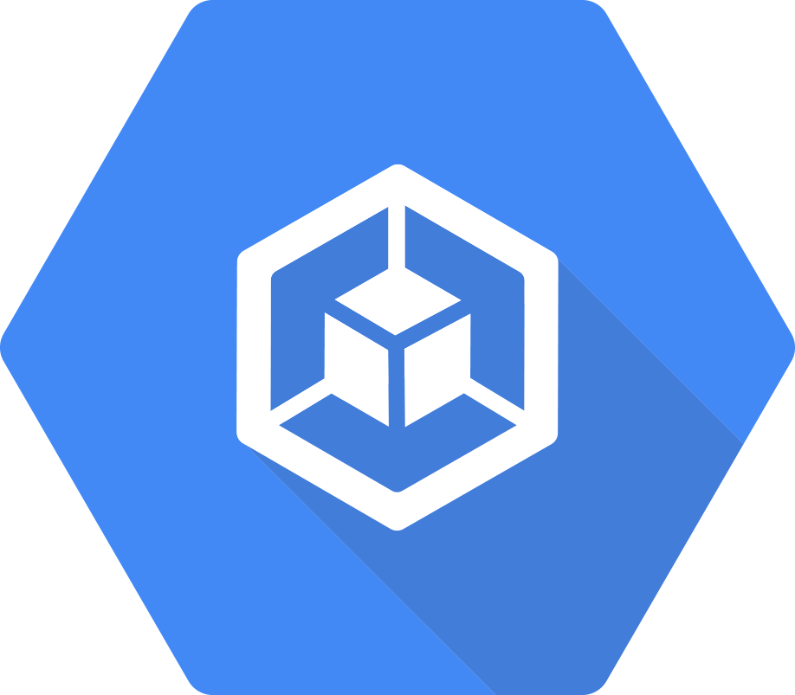













kubectl rolling-update my-web-server --rollback
kubectl rolling-update my-web-server --image=web-server:2
kubectl scale -–replicas=2000 my-web-server
docker run my-web-server
kubectl run -–replicas=1000 my-web-server
A
B
Kubernetes Cluster
Docker Host
Node
Node
Node
Security
POD AutoScalers
Cluster AutoScalers
Network
Storage
Notes:
With docker you were able to run a single instance of an application using the docker run command. Which is great! Running an application has never been so easy before.
With kubernetes, using the kubernetes CLI known as kubectl, <c> you can run a 1000 instance of the same application with a single command. <c> Kubernetes can scale it up to 2000 with another command.
<c> Kubernetes can even be configured to do these automatically so that instances and the infrastructure itself can scale up and down based on user load.
<c> Kubernetes can upgrade these 2000 instances of application in a rolling fashion one at a time, with a single command. <c> If something goes wrong, it can help you roll back these images with a single command.
<c> Kubernetes can help you test new features of your application by only upgrading a percentage of these instances through A/B testing methods.
<c> The Kubernetes open architecture provides support for many many different network and storage vendors. Any network or storage brand you can think of has a plugin for kubernetes.
<c> Kubernetes supports a variety of authentication and authorization mechanisms.
<c> All major cloud service providers have native support for kubernetes.
So what's the relation between Docker and Kubernetes. <c> Kubernetes uses Docker hosts to host applications in the form of Docker containers. Well it need not be Docker all the time, kubernetes supports alternatives to Docker as well, such as Rocket or Crio.

Slide 141

Nodes
(Minions)
Node
Notes:
Like Docker swarm kubernetes is also a Container Orchestration solution. It uses Docker hosts to host applications in the form of containers. Well it need not be Docker all the time, kubernetes supports alternatives to Docker as well, such as Rocket or Crio.
Let us start with Nodes. A node is a machine – physical or virtual – on which kubernetes is installed. A node is a worker machine and this is were containers will be launched by kubernetes.
<click>
It was also known as Minions in the past. So you might here these terms used inter changeably.
<click>
But what if the node on which our application is running fails? Well, obviously our application goes down. So you need to have more than one nodes. <click>

Slide 142
Cluster
Node
Node
Node
Notes:
<click>
A cluster is a set of nodes grouped together. This way even if one node fails you have your application still accessible from the other nodes. Moreover having multiple nodes helps in sharing load as well.

Slide 143
Master
Master
Node
Node
Node
Notes:
Now we have a cluster, but who is responsible for managing the cluster? Were is the information about the members of the cluster stored? How are the nodes monitored? When a node fails how do you move the workload of the failed node to another worker node? That’s were the Master comes in. The master is another node with Kubernetes installed in it, and is configured as a Master. The master watches over the nodes in the cluster and is responsible for the actual orchestration of containers on the worker nodes.

Slide 144

Components
Kube
Container Runtime
Controller
Scheduler
API Server
etcd
kubelet
Notes:
When you install Kubernetes on a System, you are actually installing the following components. An API Server. An ETCD service. A kubelet service. A Container Runtime, Controllers and Schedulers.
<click> The API server acts as the front-end for kubernetes. The users, management devices, Command line interfaces all talk to the API server to interact with the kubernetes cluster.
<click>
Next is the ETCD key store. ETCD is a distributed reliable key-value store used by kubernetes to store all data used to manage the cluster. Think of it this way, when you have multiple nodes and multiple masters in your cluster, etcd stores all that information on all the nodes in the cluster in a distributed manner. ETCD is responsible for implementing locks within the cluster to ensure there are no conflicts between the Masters.
<click> <click>
The scheduler is responsible for distributing work or containers across multiple nodes. It looks for newly created containers and assigns them to Nodes.
<click><click>
The controllers are the brain behind orchestration. They are responsible for noticing and responding when nodes, containers or endpoints goes down. The controllers makes decisions to bring up new containers in such cases.
<click><click>
The container runtime is the underlying software that is used to run containers. In our case it happens to be Docker.
<click><click>
And finally kubelet is the agent that runs on each node in the cluster. The agent is responsible for making sure that the containers are running on the nodes as expected.

Slide 145




Master vs Worker Nodes
Master
Worker Node
</> kube-apiserver
</> kubelet
etcd
controller
scheduler
Container Runtime
CRI-O
Notes:
So far we saw two types of servers – Master and Worker and a set of components that make up Kubernetes. But how are these components distributed across different types of servers. In other words, how does one server become a master and the other slave?
The worker node (or minion) as it is also known, is were the containers are hosted. For example Docker containers, and to run docker containers on a system, we need a container runtime installed. And that’s were the container runtime falls. In this case it happens to be Docker. <click> This doesn’t HAVE to be docker, there are other container runtime alternatives available such as Rocket or CRIO. But throughout this course we are going to use Docker as our container runtime.
<click>
The master server has the kube-apiserver and that is what makes it a master.
<click>
Similarly the worker nodes have the kubelet agent that is responsible for interacting with the master to provide health information of the worker node and carry out actions requested by the master on the worker nodes.
<click>
All the information gathered are stored in a key-value store on the Master. The key value store is based on the popular etcd framework as we just discussed.
<click>
The master also has the controller manager and the scheduler.
There are other components as well, but we will stop there for now. The reason we went through this is to understand what components constitute the master and worker nodes. This will help us install and configure the right components on different systems when we setup our infrastructure.

Slide 146



kubectl
kubectl run hello-minikube
kubectl cluster-info
kubectl get nodes
kubectl run my-web-app --image=my-web-app --replicas=100
Notes:
And finally, we also need to learn a little bit about ONE of the command line utilities known as the kube command line tool or kubectl or kube control as it is also called. The kube control tool is the kubernetes CLI which is used to <s> deploy and manage applications on a kubernetes cluster, to get cluster information, get the status of nodes in the cluster and many other things.
The kubectl run command is used to deploy an application on the cluster. The kubectl cluster-info command is used to view information about the cluster and the kubectl get nodes command is used to list all the nodes part of the cluster.
To run 100s of instances of my application across 100s of nodes, all I need is a single kubernetes command like this.
Well, that’s all we have for now. A quick introduction to kubernetes and its architecture.

Slide 148
Conclusion
Notes:
So we are at the end of this beginners course to Docker. I hope you had a great learning experience. If so please leave a comment below.

Slide 149






Conclusion
Notes:
If you like my way of teaching, you will love my other courses hosted on my site at KodeKloud. We have courses for Docker Swarm, Kubernetes, Advanced courses on Kubernetes Certifications, as well as OpenShift. We have courses for automation tools like Ansible, Chef and Puppet. Visit kodekloud at www.kodeloud.com. Well, thank you so much for your time, and until next time, Good Byeee!

Slide 150



Share
We would be absolutely thrilled if you took a selfie with your class and share it on social media while tagging us.

Slide 151



Win KodeKloud Merch for your Team
Talk to us for a chance to win exclusive KodeKloud merchandises for your team.
Just fill this form out
Or email: teachlikeus@kodekloud.com

